Slide 1
Demystifying credit risk capital requirements for housing loans Anthony Coleman & Niruba Thavabalan Melbourne Money and Finance Conference, February 2024

Slide 2
Introduction
APRA’s capital requirements for housing lending aim to ensure that banks have sufficient capital to withstand shocks and absorb losses
Two key questions
How does APRA ensure that capital requirements are sufficient to cover losses through the cycle?
How does APRA ensure that differences in IRB and standardised capital requirements are appropriate and limit impacts on competition in the Australian banking system?
2

Slide 3
There are two approaches for calculating credit risk capital requirements
The standardised and IRB approaches are based on the internationally agreed Basel framework with some modifications for Australian circumstances and risks
Standardised approach
Internal ratings-based (IRB) approach
Caters for a wide range of banks and portfolios
Simple and conservative
Risk-weights are prescribed by APRA
Tailored to the risks of an individual bank
Seeks to better align capital with risk
Risk-weights are based on internal risk models

Slide 4
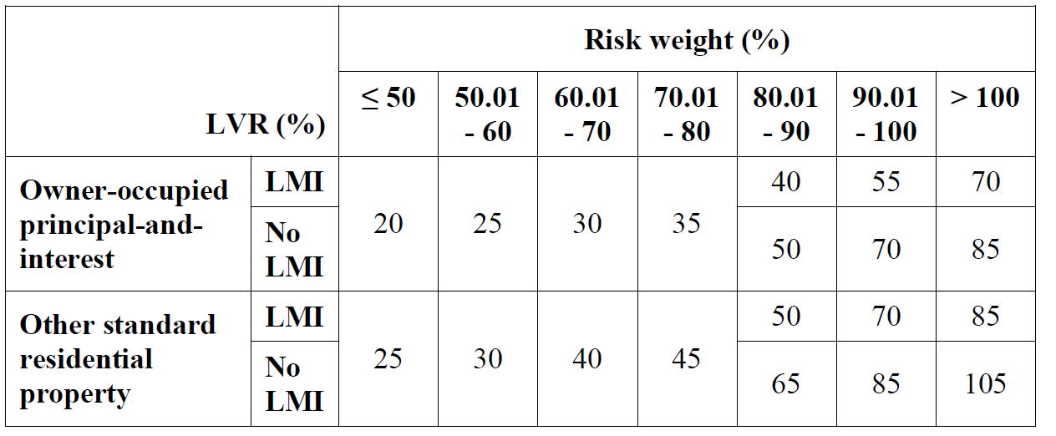
Standardised risk-weights are simple and conservative
Standardised housing risk-weights
Standard loan
Non-standard loan
Owner-occupied principal & interest
Other e.g. investment, interest only
4

Slide 5
IRB risk-weights are sensitive to a wider range of portfolio risk characteristics
Borrower characteristics e.g. DTI ratio, single or joint borrower, occupation, self-employed or PAYG
Loan characteristics e.g. LVR, owner-occupied or investment, interest only or P&I, revolving or amortising
Behavioural characteristics e.g. payments ahead of schedule, transaction and payment history, arrears history, behaviour on other retail products
Collateral characteristics e.g. property type, location, number of properties
Internal estimates of PD, LGD and EAD
Key determinants of IRB capital requirements
Risk-weight function (determines unexpected losses at a 99.9 per cent confidence level)
Asset correlation factor (15 per cent)
Scaling factors (applied at an overall level and to different categories of housing lending)
Risk parameters prescribed by APRA

Slide 6
Adequacy of capital requirements through the cycle

Slide 7
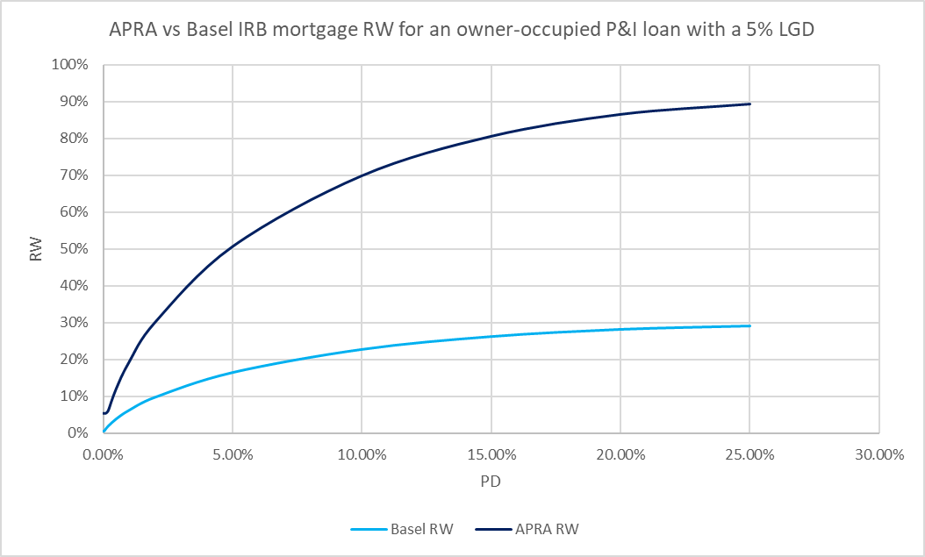
The robustness of the regulatory framework promotes confidence in the adequacy of capital requirements for housing lending
APRA’s requirements are underpinned by the internationally agreed Basel framework
APRA has strengthened the framework beyond minimum Basel requirements given the high concentration of housing loans in Australian banks’ portfolios
Overall scaling factor applied to risk-weights (IRB)
Non-standard loans and LMI recoveries cannot be modelled (IRB)
Higher risk-weights for interest only loans (IRB, standardised)
Higher risk-weights for investment loans (IRB, standardised)
Higher input floors (IRB)
Risk-weight floor (IRB)

Slide 8
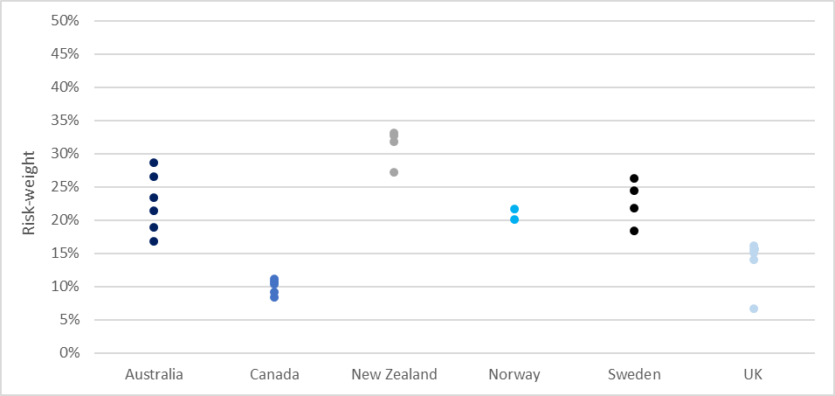
IRB risk-weights in Australia do not appear to be out of line with other jurisdictions
Other jurisdictions have increased risk-weights in response to domestic housing market conditions, the availability of downturn data and robustness of modelling practices
The dispersion in risk-weights across large banks internationally reflects differences in housing markets where banks operate and additional supervisory measures implemented

Slide 9
Rigorous ongoing supervision of IRB banks contributes to the strength of the capital framework
Regulatory approval
On-site prudential reviews
Off-site data analysis
APRA approval is required for changes to IRB models and estimates
Model changes must have sound motivation and supporting evidence
Model changes must have undergone a robust governance process within the bank
Aims to assess the health of IRB models and robustness of governance and model risk management practices
Banks are expected to proactively identify issues and have credible plans to address them in a timely manner
Supervisory issues may result in temporary increases in capital held
Banks must submit data to APRA on a quarterly basis
Analysis of trends and outliers in the data may result in further investigations
Additional data collections may be initiated to facilitate peer benchmarking

Slide 10
Differences between IRB and standardised capital requirements

Slide 11
How and why do IRB and standardised capital requirements differ?
Standardised approach
Standardised risk-weights are calibrated at a conservative level
Caters for a wide range of banks and portfolios
Recognises that the standardised approach is simple and less risk-sensitive
Ensures that banks are adequately capitalised overall
IRB approach
IRB capital requirements are generally lower in aggregate
Encourages investment by banks in advanced modelling capability, technology, data and specialist skills given significant required costs
Enables banks to more accurately allocate capital for risk

Slide 12
Mechanisms are in place to prevent excessive divergence between IRB and standardised capital requirements
New
New
Output floor:
IRB risk-weighted assets > 72.5% of standardised risk-weighted assets
Higher capital buffer requirement for IRB banks (+125bps)
Rigorous APRA approval and validation process for IRB models
Strengthened
New
Strengthened
Minimum values for IRB risk estimates and risk-weights
Lower standardised risk-weights for lower risk mortgage loans
IRB disclosure requirements

Slide 13
Differences between the IRB and standardised approaches are narrower than headline risk-weights may imply
Minimum capital ratio requirement
IRB banks have an additional capital buffer requirement of 125 bps
Technical adjustments
IRB banks must make an adjustment for expected losses and apply higher exposure amounts for certain exposures
Interest rate risk
IRB banks must hold capital for interest rate risk in the banking book
Operational costs
There are significant costs from investing in, and maintaining, IRB data and risk management systems
Responsiveness
IRB capital requirements are more responsive to changes in risk and the economic cycle and will tend to increase during periods of stress

Slide 14
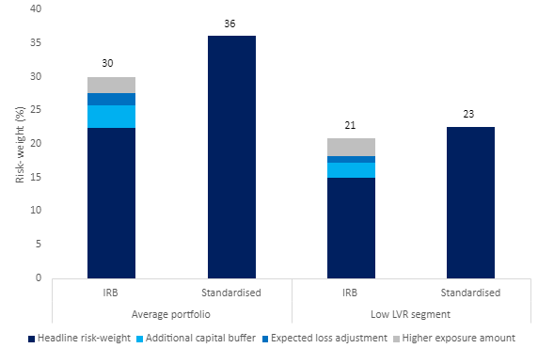
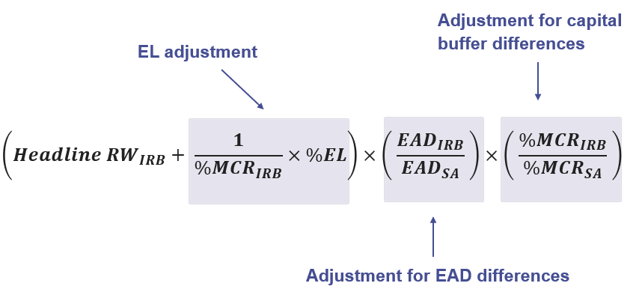
On average, differences in IRB and standardised capital requirements for housing lending are relatively small
When taking into account differences in the minimum capital ratio requirement and other technical adjustments, the average pricing differential due to differences in IRB and standardised capital requirements is estimated to be 5 bps
Adjusted IRB risk-weight

Slide 15
Conclusion
How does APRA ensure that capital requirements are sufficient to cover losses through the cycle?
Robust regulatory framework
Rigorous ongoing supervision
How does APRA ensure that differences in IRB and standardised capital requirements are appropriate and limit impacts on competition?
Capital requirements are carefully calibrated to provide an incentive for banks to improve risk management and better align capital with risk
Mechanisms are in place to prevent excessive divergence between IRB and standardised requirements
15

Slide 16
Thank you
Copyright © Australian Prudential Regulation Authority (APRA)
16

