Slide 1

Acknowledgement of Country

Slide 2
FBE Teaching and Learning Development Grant
Round 1 2026
Information session
CRICOS

Slide 3


Aim
Aligned with the Advancing Students and Education Strategy: 2023–2030 and the University’s Framework for Educational Excellence, the Teaching and Learning Development Grants program aims to support FBE academics to redesign subject curricula and implement innovative teaching and learning activities to improve student learning.

Slide 4
Key dates
Grants opened
    10 March 2026
  Closing date
  1 May 2026
  Grants awarded
  Late May 2026
Progress report due
    Early December 2026
  Final report due
  June 2027
  1-year projects

Slide 5
Categories
Developing and trialling new forms of assessment which encourage greater engagement with learning
Innovative teaching and learning strategies to improve feedback on and for learning
Transforming subject delivery to enhance the on campus and/or blended learning experience for students
Trialling an innovative use of multimedia or new technologies
Introducing experiential learning into the curriculum for a subject or set of subjects within an academic program

Slide 6
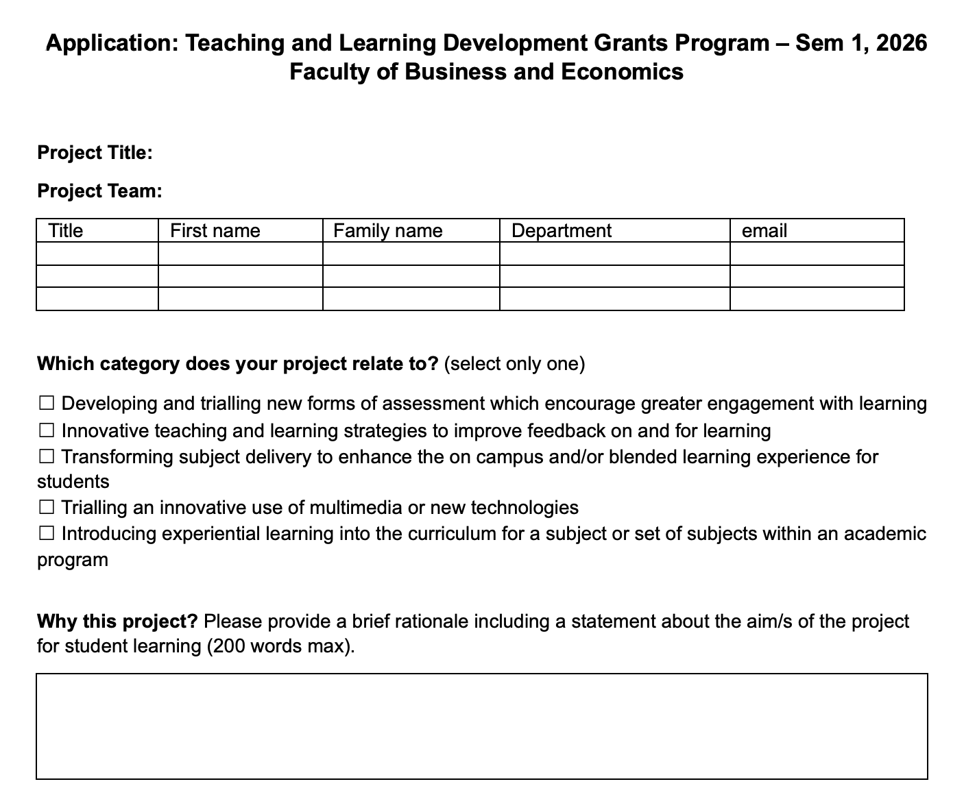
Filling out the form: rationale
Choose one category only
Rationale
      Alignment (policy, strategy)
      Scholarship/evidence

Slide 7
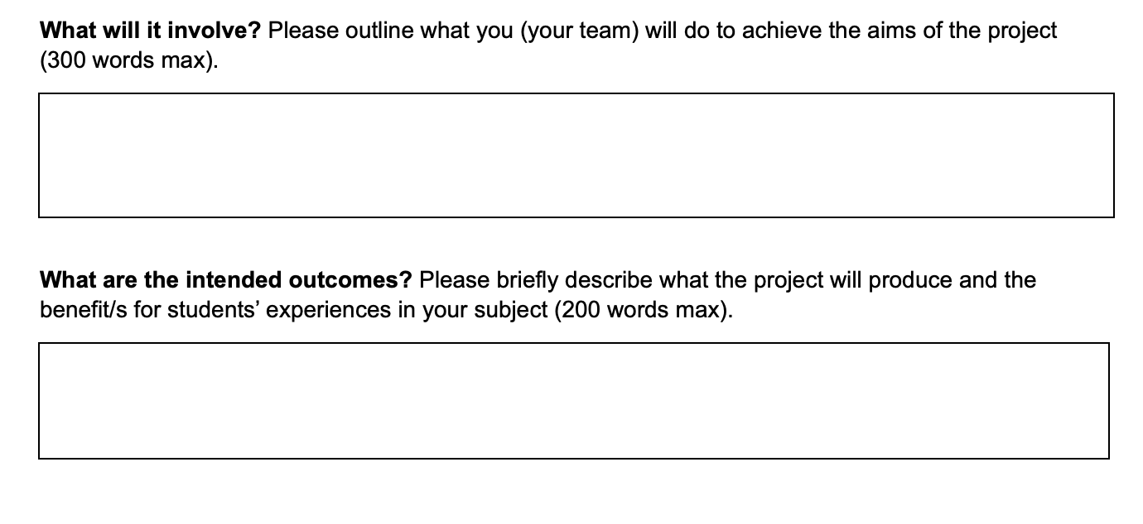
Filling out the form: aims and outcomes
Clarity: What is the intervention or initiative? Be clear.
Are there tangible artifacts?
What are the benefits to your students/practice?
What are the potential benefits to future students/others’ practice?

Slide 8
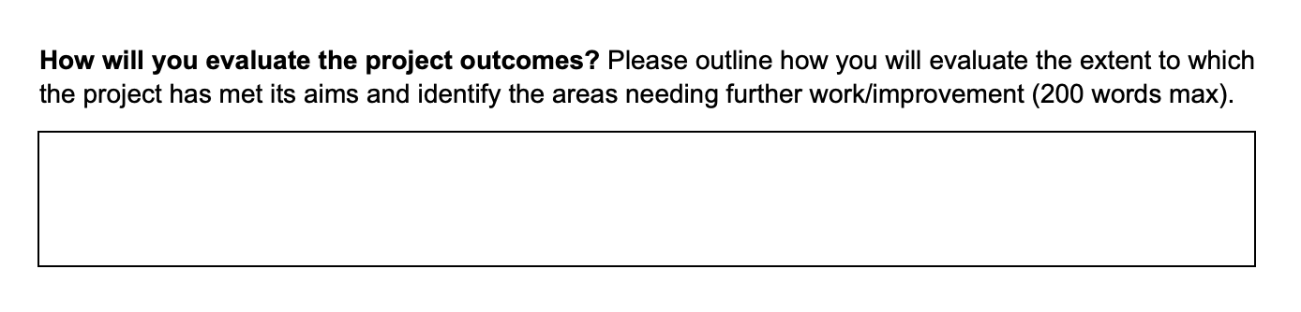
Filling out the form: evaluation
Quant, qual, or mixed methods
Do the evaluation methods align with the aim/s of the project?
Capacity and feasibility
  Team capability
  Team size

Slide 9
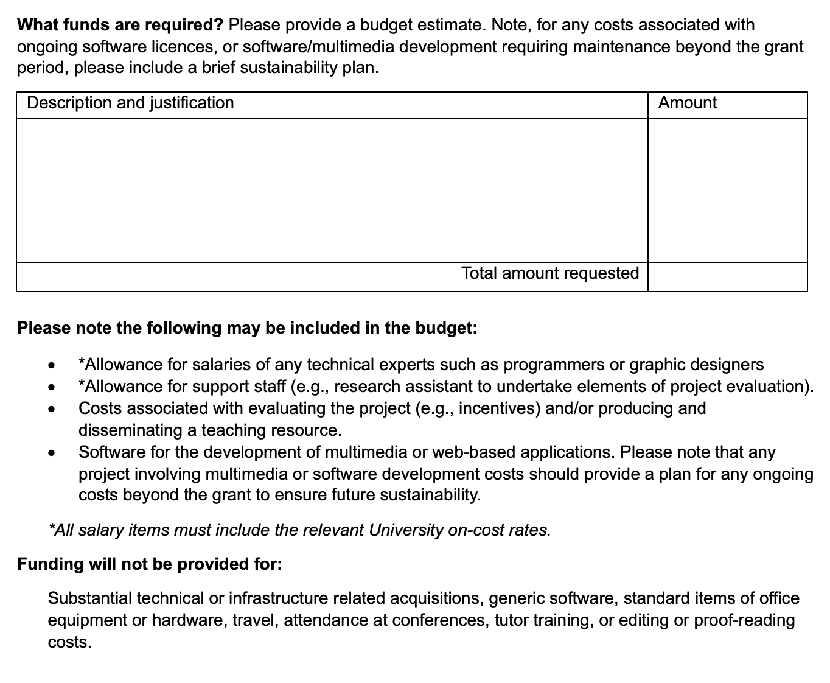
Filling out the form: budget
Accurate costings
Salary costing tool KB article
Justification
Sustainability

Slide 10
Giving yourself the best chance at success
Alignment
      Policy and strategy
      Your own interests/narrative as an educator
    Scholarship
      Provide evidence/rationale
    Clarity
    Sustainability
    Seek support
      Colleagues
      WCLA

Slide 11
Q&A
The University of Melbourne (Australian University) PRV12150
CRICOS 00116K

