Slide 1
How Perception Affects House Prices
Evidence from Failed Auctions
Kristle Romero Cortés
Mandeep Singh
David H. Solomon
Philip E. Strahan

Slide 2
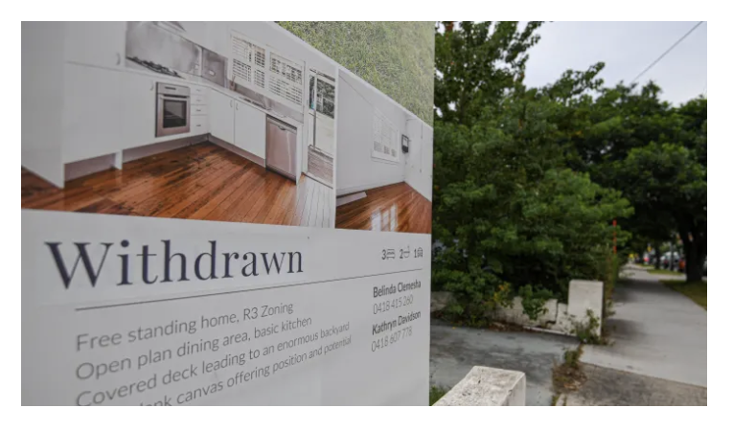
Auctions
Why use auctions?
Highly visible
Meant to draw attention
Discrete event
17% fail
Embarrassing
Selling agents say reputational risks

Slide 3
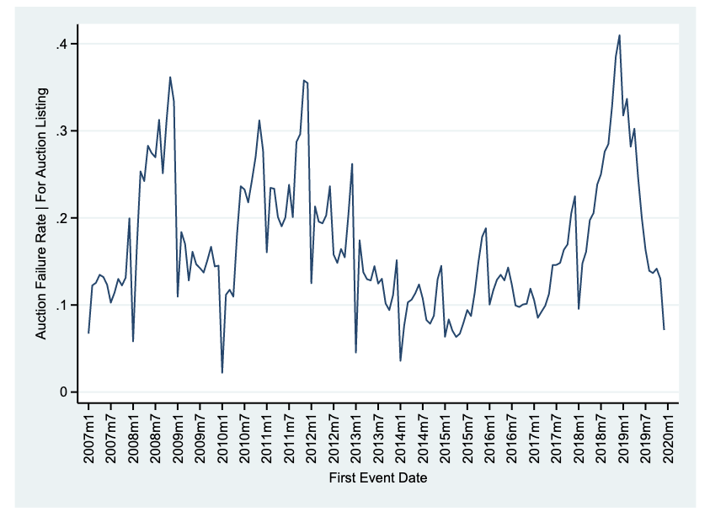
Auction Failure Rate
Data source: Domain Auction Listings

Slide 4
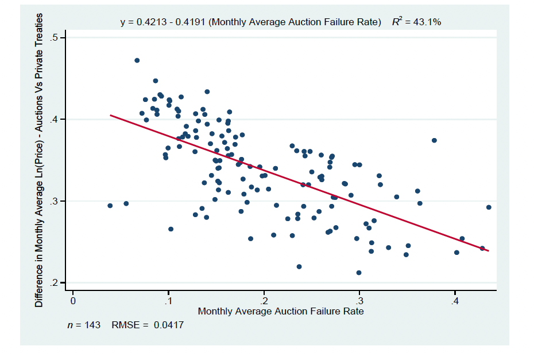
Auction Failure
Gives impression something is wrong with the house but…
Not necessarily true! It is a bad news event but if something were truly wrong, the auction should succeed but at a lower price >>
Reserve Price Mismatch

Slide 5
Research Findings
Auctions Results
Instruments
Is this stigma?
Repeated Sales
Property Fixed Effects
Successful auctions sell at a premium.
0.7%
Failed auctions sell at a discount.
1.7%
Causal claims and use IV
Precipitation
Rain
The discount decreases with time. On average taking 6 months to fade completely.
Effect around “round”
numbers

Slide 6
Timeline Allows us to Exploit Events
Decide to Sell Home
Decide on a Private Treaty or Auction
Auction Day
Data is from Domain.com.au for NSW and VIC from 2007-2019

Slide 7
Using Rain to instrument Auction Failure
Private Treaty – Sale price $ XXX,XXX
Successful Auction – Sells on the day for a premium
Failed Auction – Sells at a later date for a discount
Identical
Homes

Slide 8
Concluding Remarks
Australia’s Residential Real Estate Market is rife with research opportunities however we must first understand some of the fundamental differences of the industry
The Auction sales method itself is useful to understand but it also presents a setting to answers an even larger research question, can market efficiency overcome basic human reactions
The could potentially spillover to other embarrassing events in asset pricing (Failed IPOs) and other markets (labor: long unemployment spells)
This paper shows there is a role for human psyche in determining prices heavily affected by a consumer's willingness to pay.

