Slide 1
We are a politically independent research institute formed to address the key economic policy questions facing Australia
Our analysis emphasises:
Currently structured around four units:
Academic rigour
World class microdata
State of the art techniques
Policy engagement
Broad-based Prosperity
How can we increase living standards in an inclusive and sustainable way?
HOUSING
EDUCATION
SOCIAL POLICY
STRUCTURAL POLICY
Household mobility and location choices
Housing affordability
Housing supply and prices
Skills, education and labour market outcomes
Gender pay gaps
Childcare costs and labour force participation
Jobseeker and labour supply
Disability support and employment barriers
Income support and poverty traps
Industrial relations
Barriers to labour mobility
Innovation policy

Slide 2
Stepped on by stamp duty
The effect of housing transfer taxes on home purchases and people movement
Nicholas Garvin, Gianni La Cava, Angus Moore (PropTrack) and Aaron Wong
Melbourne Money and Finance Conference, 6 February 2024

Slide 3
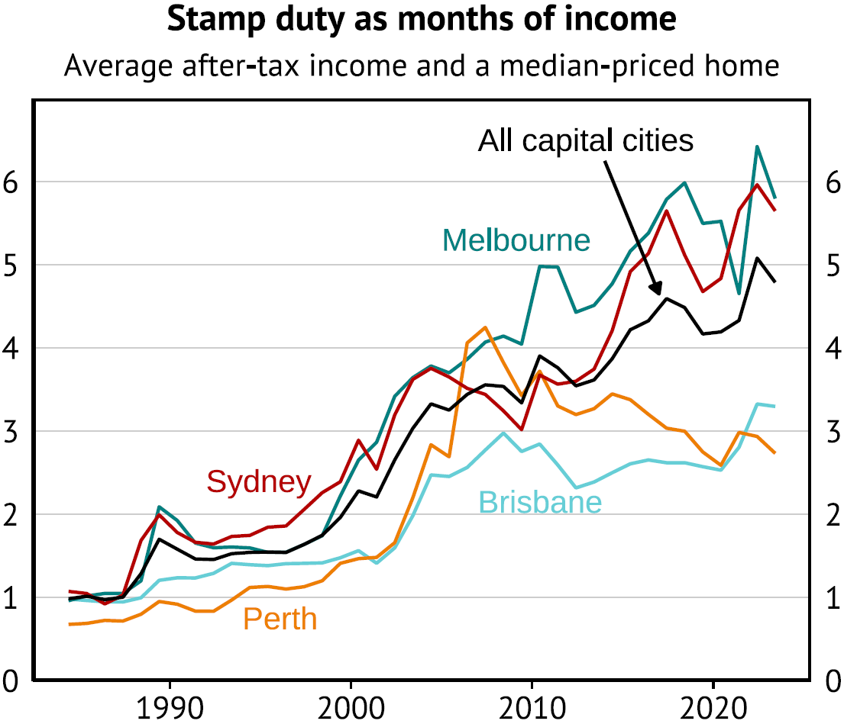
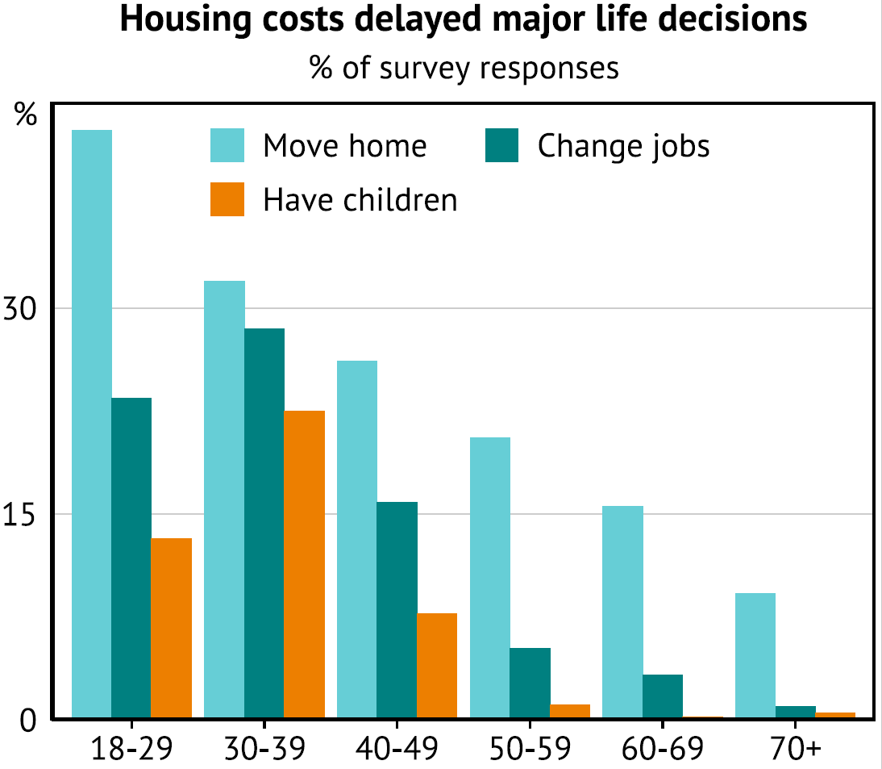
The clear costs of stamp duty
Introduction

Slide 4
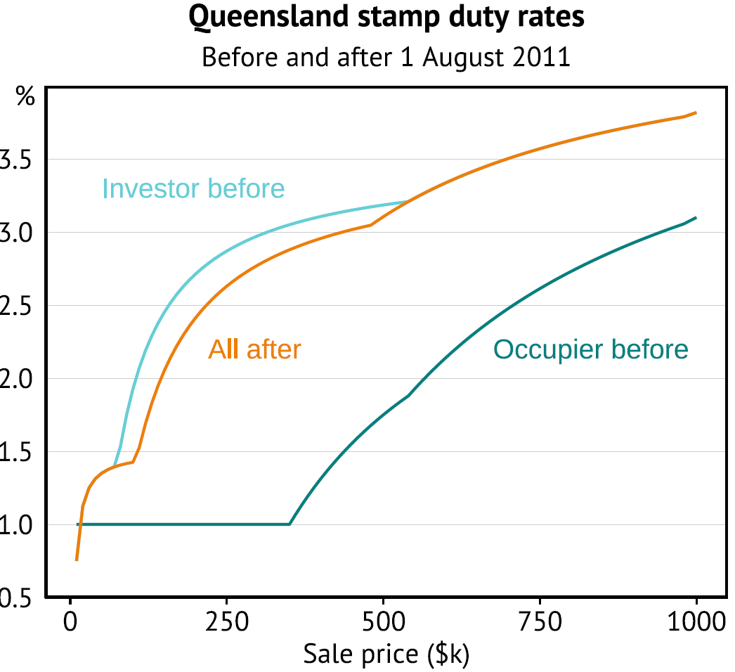
A large stamp duty change in Queensland in 2011 offers a natural experiment for identifying the sensitivity of reactions
Method I
The Queensland stamp duty change
1 August 2011: large concessions for owner occupiers removed.
1 July 2012: previous concessions re-introduced with change of government.
Change temporarily raised occupier taxes by 1% of sale price on average
Control groups: NSW, Vic, SA and WA did not change stamp duty
Method: differences-in-differences model comparing states across time

Slide 5
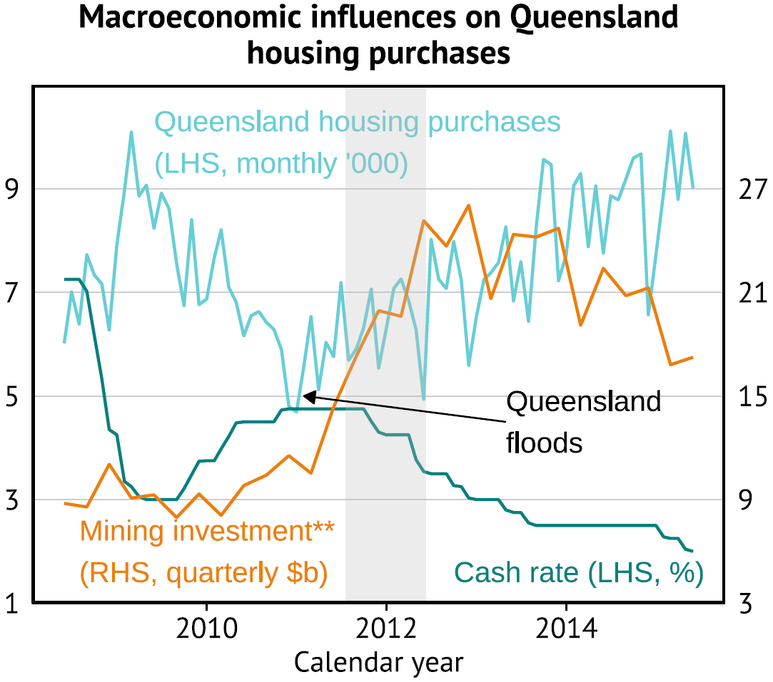
But the econometric setup still needs to deal with strong confounding influences
Method II
Methodology overview
Data: All housing purchases from PropTrack
Triple difference model:
Compare Qld outcomes with control states
Before stamp duty rise (FY 2009-11) versus during (FY 2012)
Outcome variable is number of occupier purchases minus investor purchases within a state.
Matched control group: non-Qld control areas (SA3s) chosen based on having similar FY 2009-11 trends as Qld areas
Robustness: ‘placebo test’ with identical methodology shifted back one year

Slide 6
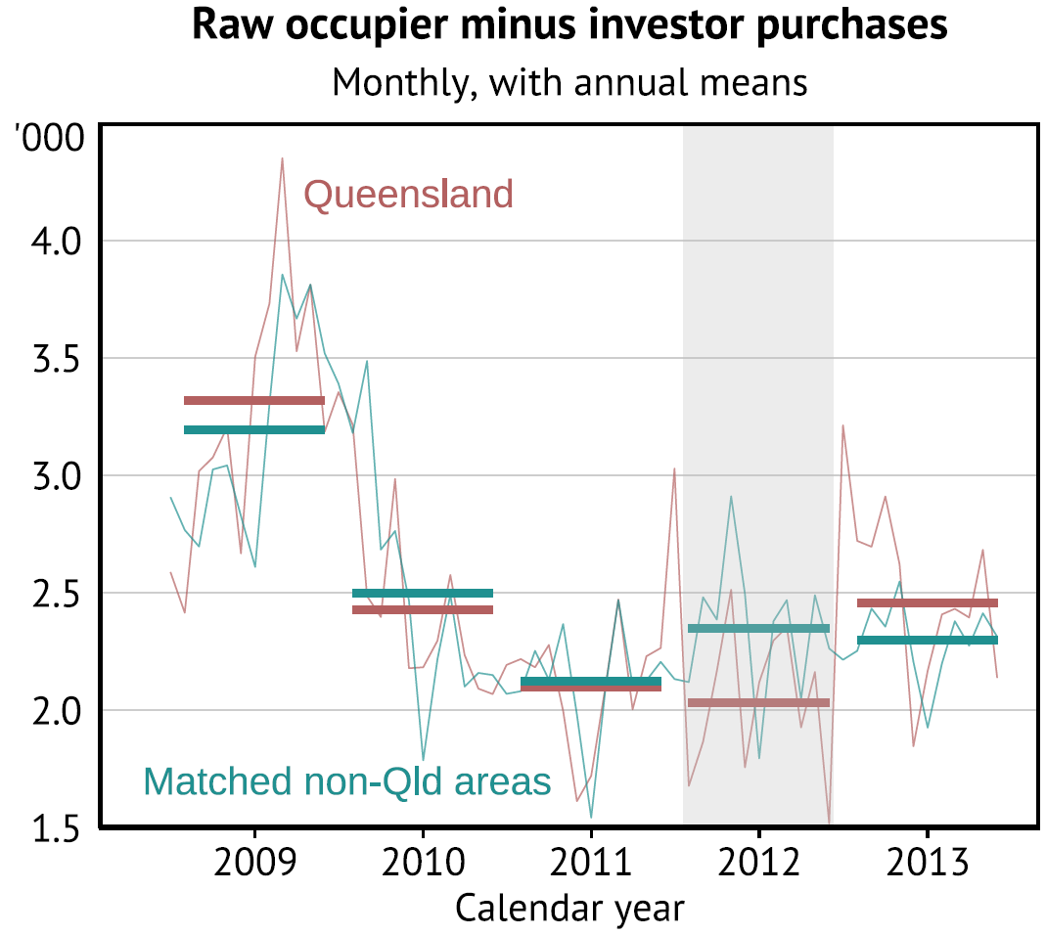
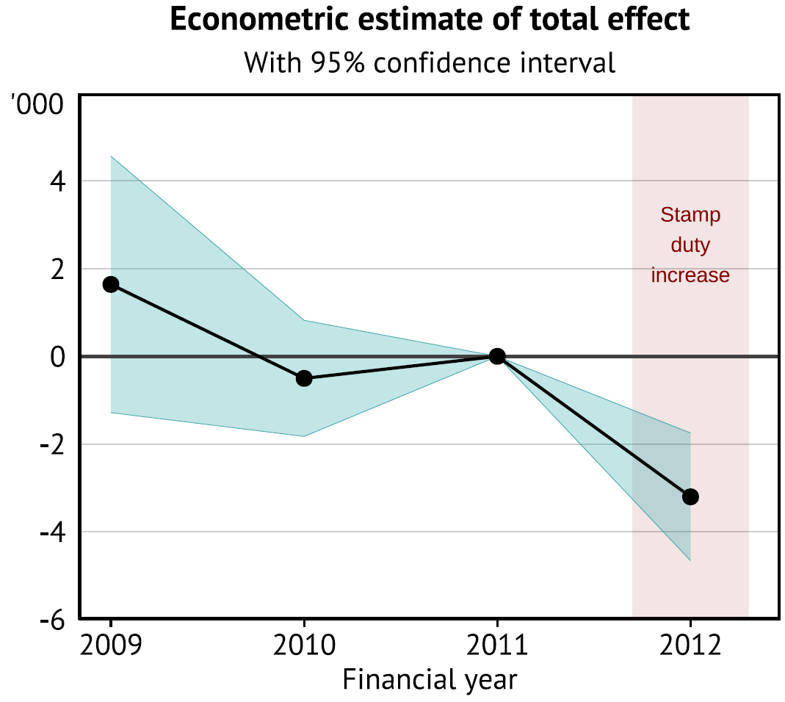
The triple difference setup shows visible and statistically significant stamp duty responses
Results I

Slide 7
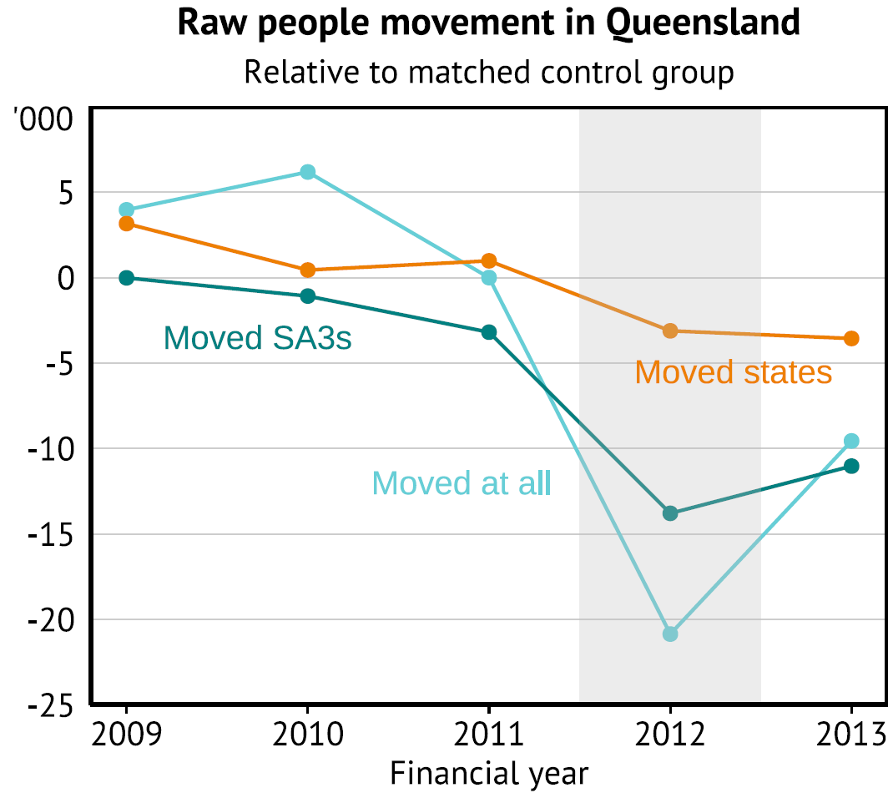
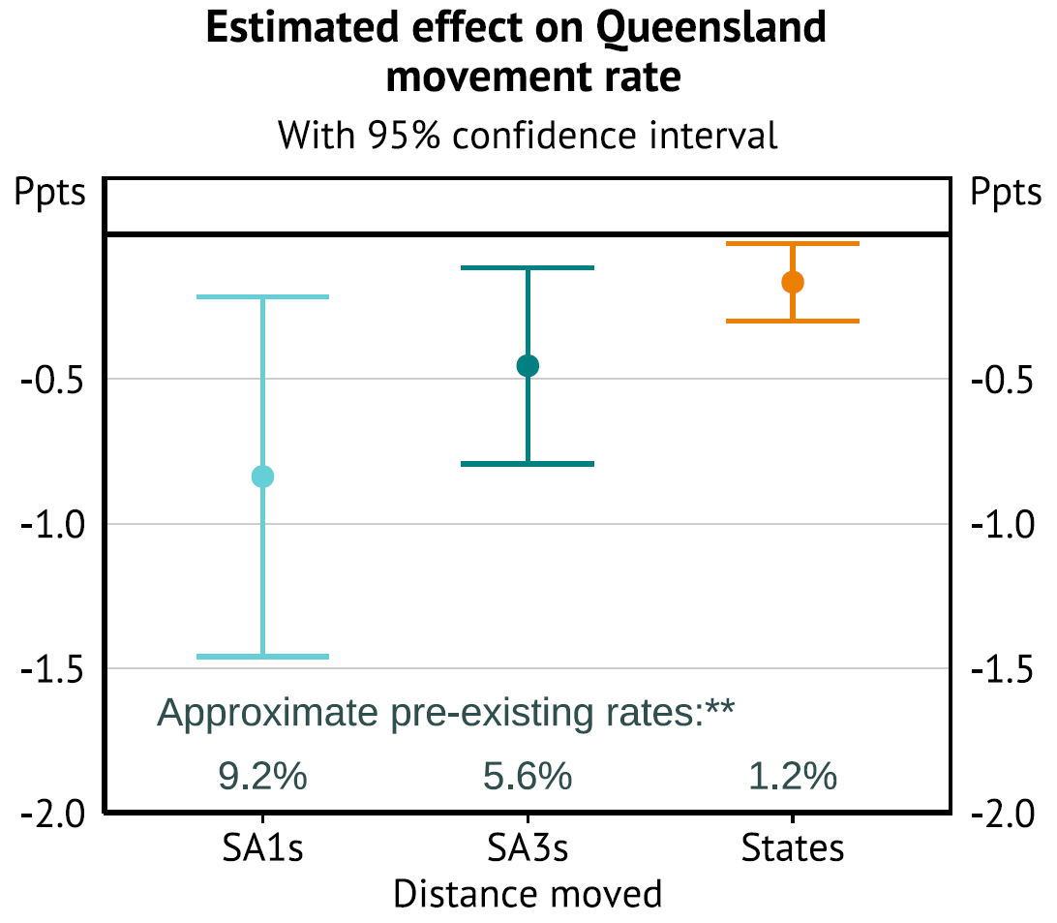
Similar modelling on people movement rates shows the same effect
Results II

Slide 8
Why the sensitivity is so high (and why stamp duty is inefficient)
Policy implications I
1 ppt change in stamp duty → 7.2% change in housing purchases
Consider a $700 000 home purchase, where stamp duty is 4% (current national median) equalling $28 000. Two amplification mechanisms, depending on the buyer type:
1. Moving homes
2. Buying a first home
Say the home being sold is $650 000
Net expenditure is $50 000
4% stamp duty is 56% tax on purchase spending
Say the mortgage finance has 80% loan-to-valuation
Requires savings of $140 000
4% stamp duty is 20% tax on savings

Slide 9
Policy implications and alternatives
Policy implications II
Stamp duty may be contributing to the productivity slowdown
Productivity depends on labour dynamism and job switching
Job switching has declined in last 20 years as stamp duty burden has grown
Previous analysis predominantly favours switching to land tax
Does not inhibit moving
Immobile tax base (i.e. more efficient than most taxes)
More stable revenue
Can be set up to avoid disadvantaging (e.g.) cash-poor home owners
But any other tax is likely an improvement
Previous work has also suggested raising tax on (e.g.):
Housing capital gains, possibly upon sale like stamp duty
Imputed rents

