Slide 1
Getting ready for studying Commerce

Slide 2
What are the key attributes and skills of Bachelor of Commerce students/ graduates?
Self-direction
Research & reading
Knowledge & thinking skills
Communication & intercultural skills

Slide 3
Key attributes / skills
engage confidently in self-directed study and research.
Self-direction
use basic mathematical and statistical tools of analysis.
recognise and understand the ethical responsibilities of individuals and organisations in society.
apply critical and analytical skills and methods to the identification, evaluation and resolution of complex problems.
Knowledge & thinking skills
critically evaluate new ideas, research findings, methodologies and theoretical frameworks in a specialised field of study.
use information from diverse sources.
Research & reading
work collaboratively and productively in groups.
communicate ideas effectively in both written and oral formats.
operate effectively in multicultural and diverse environments.
Communication & intercultural skills
From: https://handbook.unimelb.edu.au/2017/courses/b-com/attributes-outcomes-skills

Slide 4
Self-direction
Approximately how many hours should you study each week?
Go to https://qp.e.unimelb.edu.au/burniem and select:
15 hours
20 hours
30 hours
40 hours
50 hours
40h

Slide 5
Self-direction
Engage confidently in self-directed study and research.
Time is less structured, with less face-to-face time and more self-study hours.
You need to balance all your commitments: study, sports, socialising, family, job etc.
Strategies
Spread your workload over the semester: be a snack, not a binge worker.
Use planners: work out what time you have.
Set goals: know what you want to achieve.
Form study groups: share workload and support each other.

Slide 6
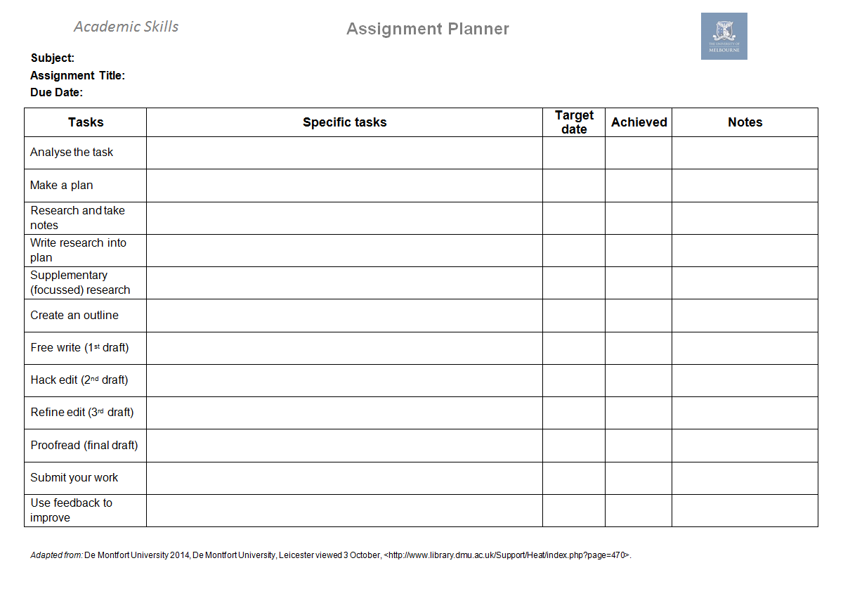
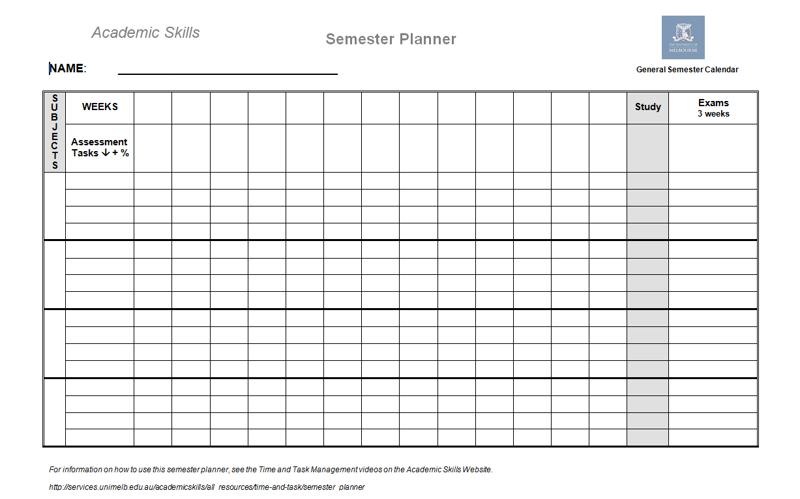
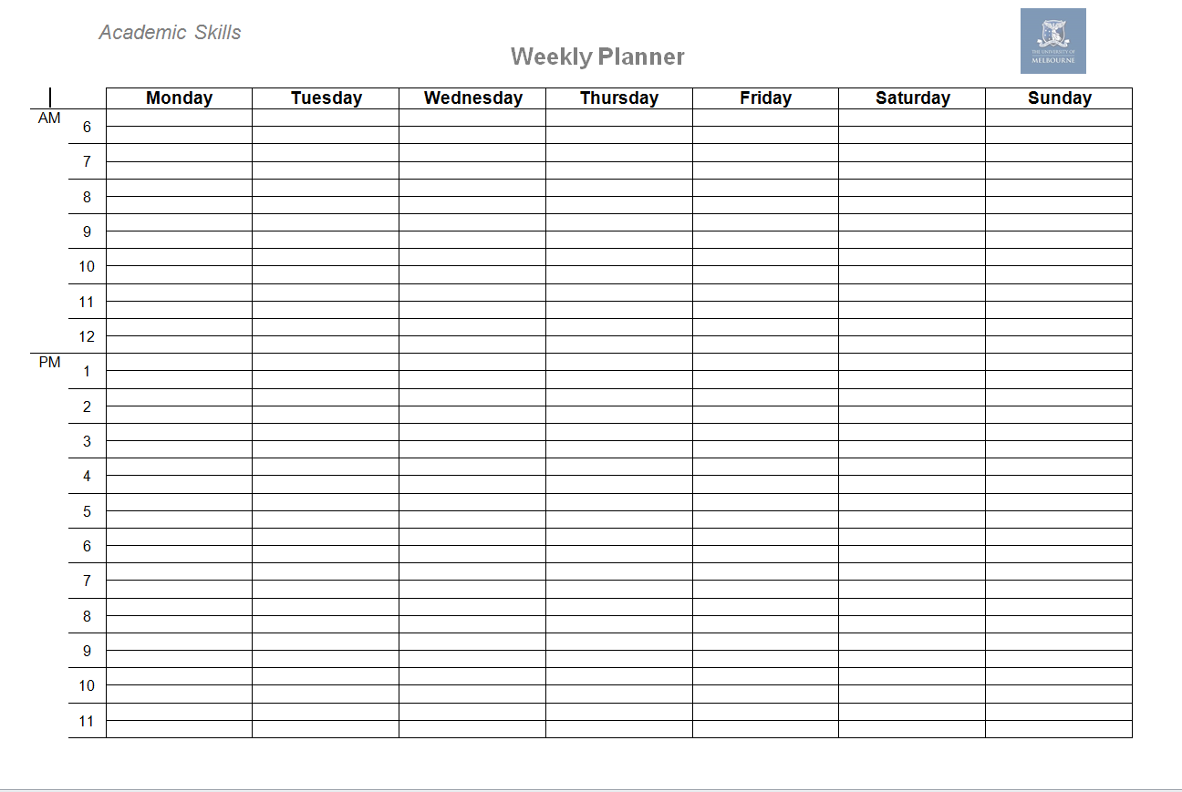
Resources
AS Hub > Study Skills > Time management
Workshops

Slide 7
Knowledge & thinking skills
Use basic mathematical and statistical tools of analysis.
Recognise and understand the ethical responsibilities of individuals and organisations in society.
Apply critical and analytical skills and methods to the identification, evaluation and resolution of complex problems.
Try to be:
creative: use your imagination
reflective: think about how you learn – what works?
effective: organise your time, space and priorities
active: do something with the material
motivated: set goals, reward yourself, be realistic

Slide 8
Active learning
Active learning strategies help you maximise your study time and enhance your memory and understanding.
It involves engaging with what you are learning – doing something with the information.
Mental transformation and manipulation of the material
e.g. summarising a theory in your own words
Matching the strategy to the material being learned
e.g. Flashcards for memorising definitions and examples, but drawing flowcharts to remember steps in a process.
Staying motivated

Slide 9
Active or passive strategies?
Which 2 strategies are the (passive) time-wasters?
Explain and debate issues with a peer / study group.
Copy out and memorise sections of readings.
Change paragraphs into charts or vice versa.
Regularly test understanding using information gaps, mnemonic devices or flashcards.
Listen to lecture recordings over and over to understand every word.
Use knowledge to solve problems / answer questions.
Go to https://qp.e.unimelb.edu.au/burniem and select:
A: 1 & 2
B: 2 & 5
C: 2 & 3
B: 2 & 5

Slide 10
Active strategies

Slide 11
Active learning: lectures
Before
Do pre-reading
Look up unfamiliar concepts / Note vocabulary
Prepare questions
During
Take notes (investigate different notetaking styles)
e.g. Cornell, two column, mind mapping etc.
AS Hub > Critical Academic Writing > Note taking
Manage attention span
After
Review within 24h
Study regularly
Read actively
Make revision notes, each week for each class
Check understanding – apply knowledge

Slide 12
Critical thinking / analysis Figure 1: Market share in the Australian ice cream industry
Little, S. (2016, April). IBISWorld Industry Report C1132: Ice Cream Manufacturing in Australia. [Major companies]. Retrieved from IBISWorld database.
Compare:
We can see from Figure 1 that market share in the Australian ice cream industry is broken down as follows: Regal Cream holds 8.9%, Unilever holds 29%, Peters Food Group has 34.8% with the remaining 27.3% held by other companies.
We can see from Figure 1 that the Australian ice-cream market is dominated by three organisations (Regal Cream Products, Unilever, and Peters Food Group) who collectively hold almost 75% of market share.
We can see from Figure 1 that the Australian ice-cream market is dominated by three organisations (Regal Cream Products, Unilever, and Peters Food Group) who collectively hold almost 75% of market share. High market share concentration can be a barrier to entry for smaller, less established brands who do not benefit from economies of scale in production and marketing.
description
analysis
analysis & interpretation

Slide 13
Critical analysis
Which sentence shows more analysis?
Go to https://qp.e.unimelb.edu.au/burniem and select:
Currently, the company relies disproportionately on North American markets for revenue (MarketLine Advantage, 2015), leaving it exposed to risks associated with political and economic fluctuations.
The Walt Disney Company relies disproportionately on North American markets for revenue (MarketLine Advantage, 2015).
A. Analyses the implication of being over-reliant on North American Markets: risks associated with political and economic fluctuations. B does not explain the implication - it merely describes the fact.

Slide 14
Research / reading skills
use information from diverse sources.
critically evaluate new ideas, research findings, methodologies and theoretical frameworks in a specialised field of study.
AS Hub > Research to Writing Process > Research, Reading and Synthesising
AS Hub > Referencing and Using Sources

Slide 15
Communication skills
Communicate ideas effectively in both written and oral formats.
Operate effectively in multicultural and diverse environments.
Work collaboratively and productively in groups.
Types of communication (genre)
Essay
Case study
Report
Executive summary
Plans / Proposals
Oral presentation
Discussions (group work / meetings etc.)…
Notes:
Audience and aim!

Slide 16
Academic / Professional writing
Think about genre, aim and audience
Follow a writing process: step by step approach
Demonstrate your critical analysis
AS Hub > Research to Writing Process
AS Hub > Critical Academic Writing
Workshops

Slide 17
Oral presentations/discussion
Prepare and practice!
Focus on:
Your brief
Your message
How your visuals and voice support your message
AS Hub > Assessment tasks > Oral presentations
AS Hub > Study Skills
Workshops

Slide 18
Reflect
What worked in the past?
What are your strengths / weaknesses
Which strategies will you try?
How are you going to measure your progress and know you’re on track?
How will you be able to apply what you’re learning to your future careers?
Good luck!

Slide 19
How can Academic Skills help?
Online resources
Workshops & courses
Individual appointments
Reading strategies
Presentation skills
Time management
Writing skills
Critical thinking
Listening & note-taking
Exam preparation
English Language
Notes:
AS provides Online resources (hub / flyers videos etc.)
We also do workshops and short courses
You can also book an individual appointment.

Slide 20
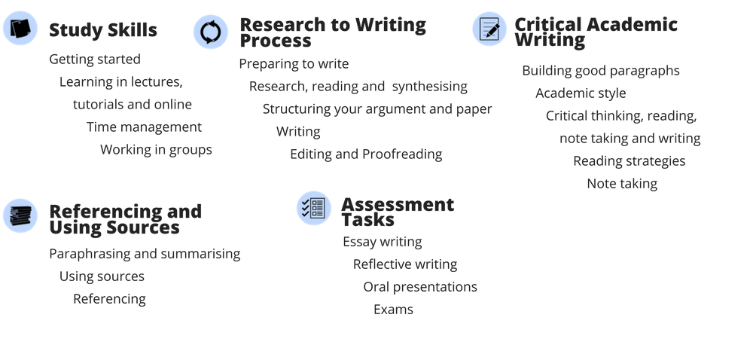
Online resources
Access from the Academic Skills website, or look under the “My Communities” tab on the right in your LMS homepage
Notes:
First stop is the hub.

Slide 21
Stay in touch
Search for: Academic Skills, The University of Melbourne
http://services.unimelb.edu.au/academicskills
Notes:
Follow us on SM.

