Slide 1
AustralianSuper assets amongst members 65yo+ are growing fast
<65
Annual growth rate: 7.5%
65+
Annual growth rate: 12.0%
Source: AustralianSuper data
1

Slide 2
Financial illiteracy is a problem
Question 1. Numeracy
Suppose you put $100 into a no-fee savings account with a guaranteed interest rate of 2% per year. You don’t make any further payments into this account and you don’t withdraw any money. How much would be in the account at the end of the first year, once the interest payment is made?
Question 2. Inflation
Imagine now that the interest rate on your savings account was 1% per year and inflation was 2% per year. After one year, would you be able to buy more than today, exactly the same as today, or less than today with the money in this account?
Question 3. Diversification
Do you think that the following statement is true or false? ‘Buying shares in a single company usually provides a safer return than buying shares in a number of different companies’. (True or false?)
Question 4. Risk–return
Again, please tell me whether you think the following statement is true or false: ‘An investment with a high return is likely to be high risk’. (True or false?)
Question 5. Money illusion
Suppose that by the year 2024 your income has doubled, but the prices of all of the things you buy have also doubled. In 2024, will you be able to buy more than today, exactly the same as today, or less than today with your income?
Source: Household, Income and Labour Dynamics in Australia (HILDA) Survey Wave 20 (2020)
2

Slide 3
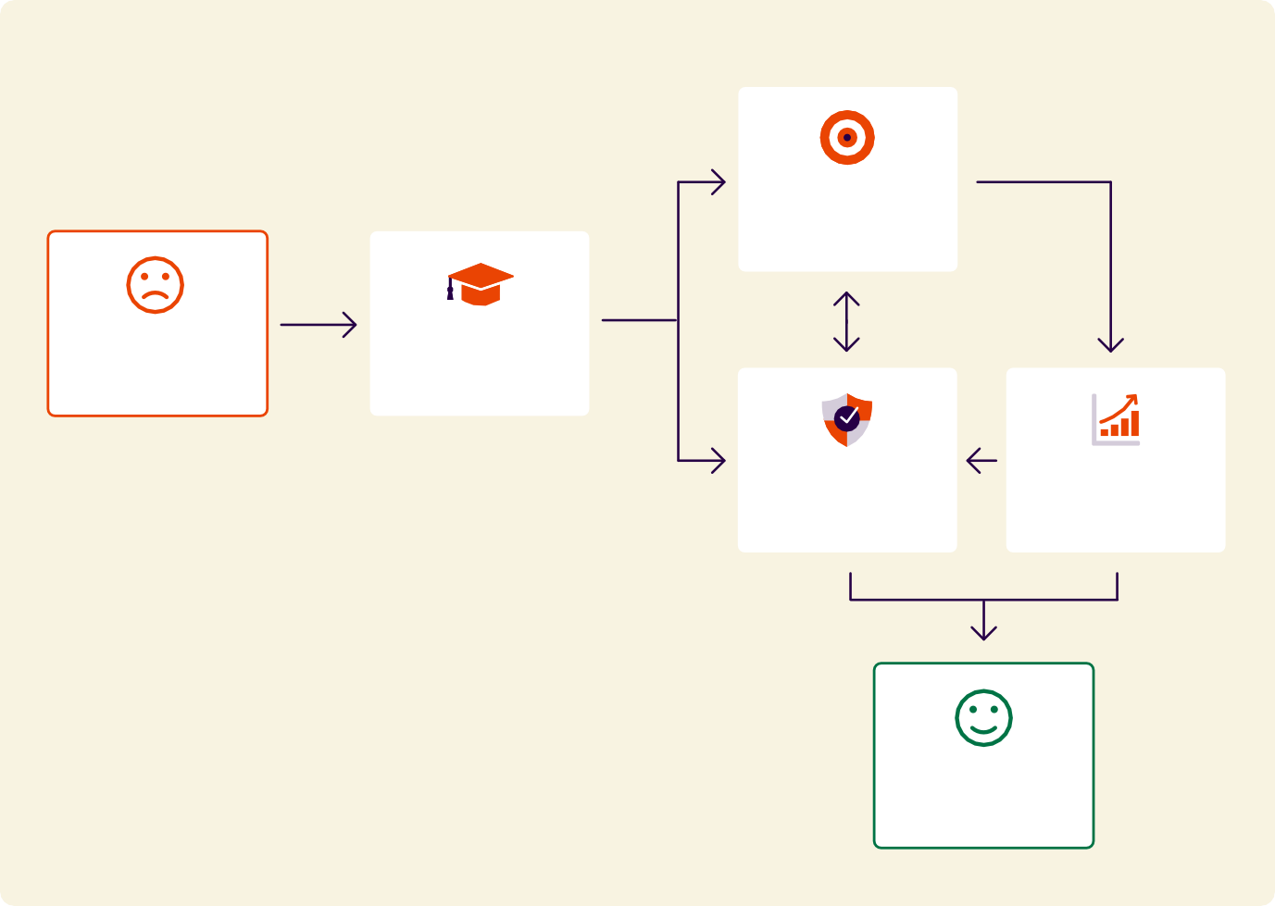
Guidance increases confidence and improves wellbeing
Flowchart – Benefits of guidance
More positive actions
Low literacy & low confidence
Receive guidance
Greater confidence
Improved financial outcomes
Improved wellbeing
3

Slide 4
For most people, super and the pension go together
Government pension
Includes all types of government allowance
Superannuation
Includes all types of annuities and allocated pensions
No personal income
Other
Source: Retirement and Retirement Intentions, Australia, Table 6.1 | Australian Bureau of Statistics
‘Other’ includes Dividends or interest, Rental property income, Own unincorporated business income, Workers' compensation, Did not know and Other sources
4

Slide 5
People deal with longevity risk through the pension
The proportion of people aged 65-69 years receiving the Age Pension has fallen dramatically
The proportion receiving the Age Pension aged 85+ has risen
Age Pension recipients represent 91% of all 65yo+ income support payment recipients in March 2025.
Spending on Australian Government Age and Service Pensions is projected to fall from around 2.3 per cent of GDP in 2022–23 to 2.0 per cent of GDP in 2062–63. Australian Government, 2023 Intergenerational Report
2015
2020
2025
Source: AIHW analysis of Department of Social Services (DSS 2025) Income Support recipients | Australian Institute of Health & Welfare (AIHW)
5

