Slide 1
Cash Rate Pass-through to Outstanding Mortgage Rates
Benjamin Ung
Melbourne Money and Finance Conference
February 2024

Slide 2
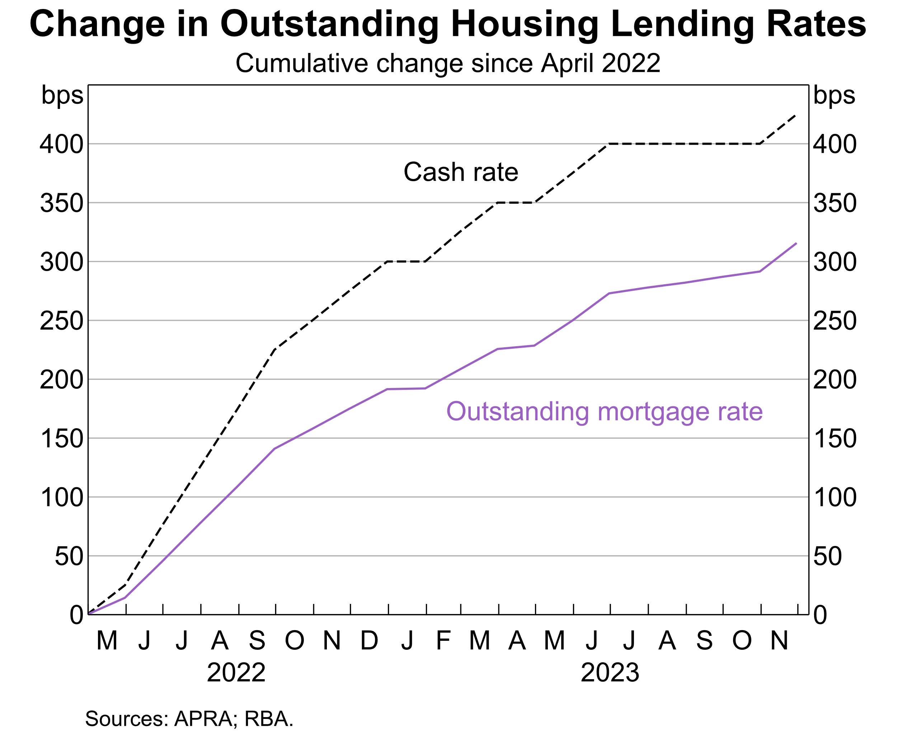

Slide 3
Outline
Fixed-rate loans have slowed the pass-through to outstanding mortgage rates.
Lending competition has also dampened pass-through to outstanding variable rates.
Pass-through to housing mortgage rates has still been an effective transmission channel for monetary policy.

Slide 4
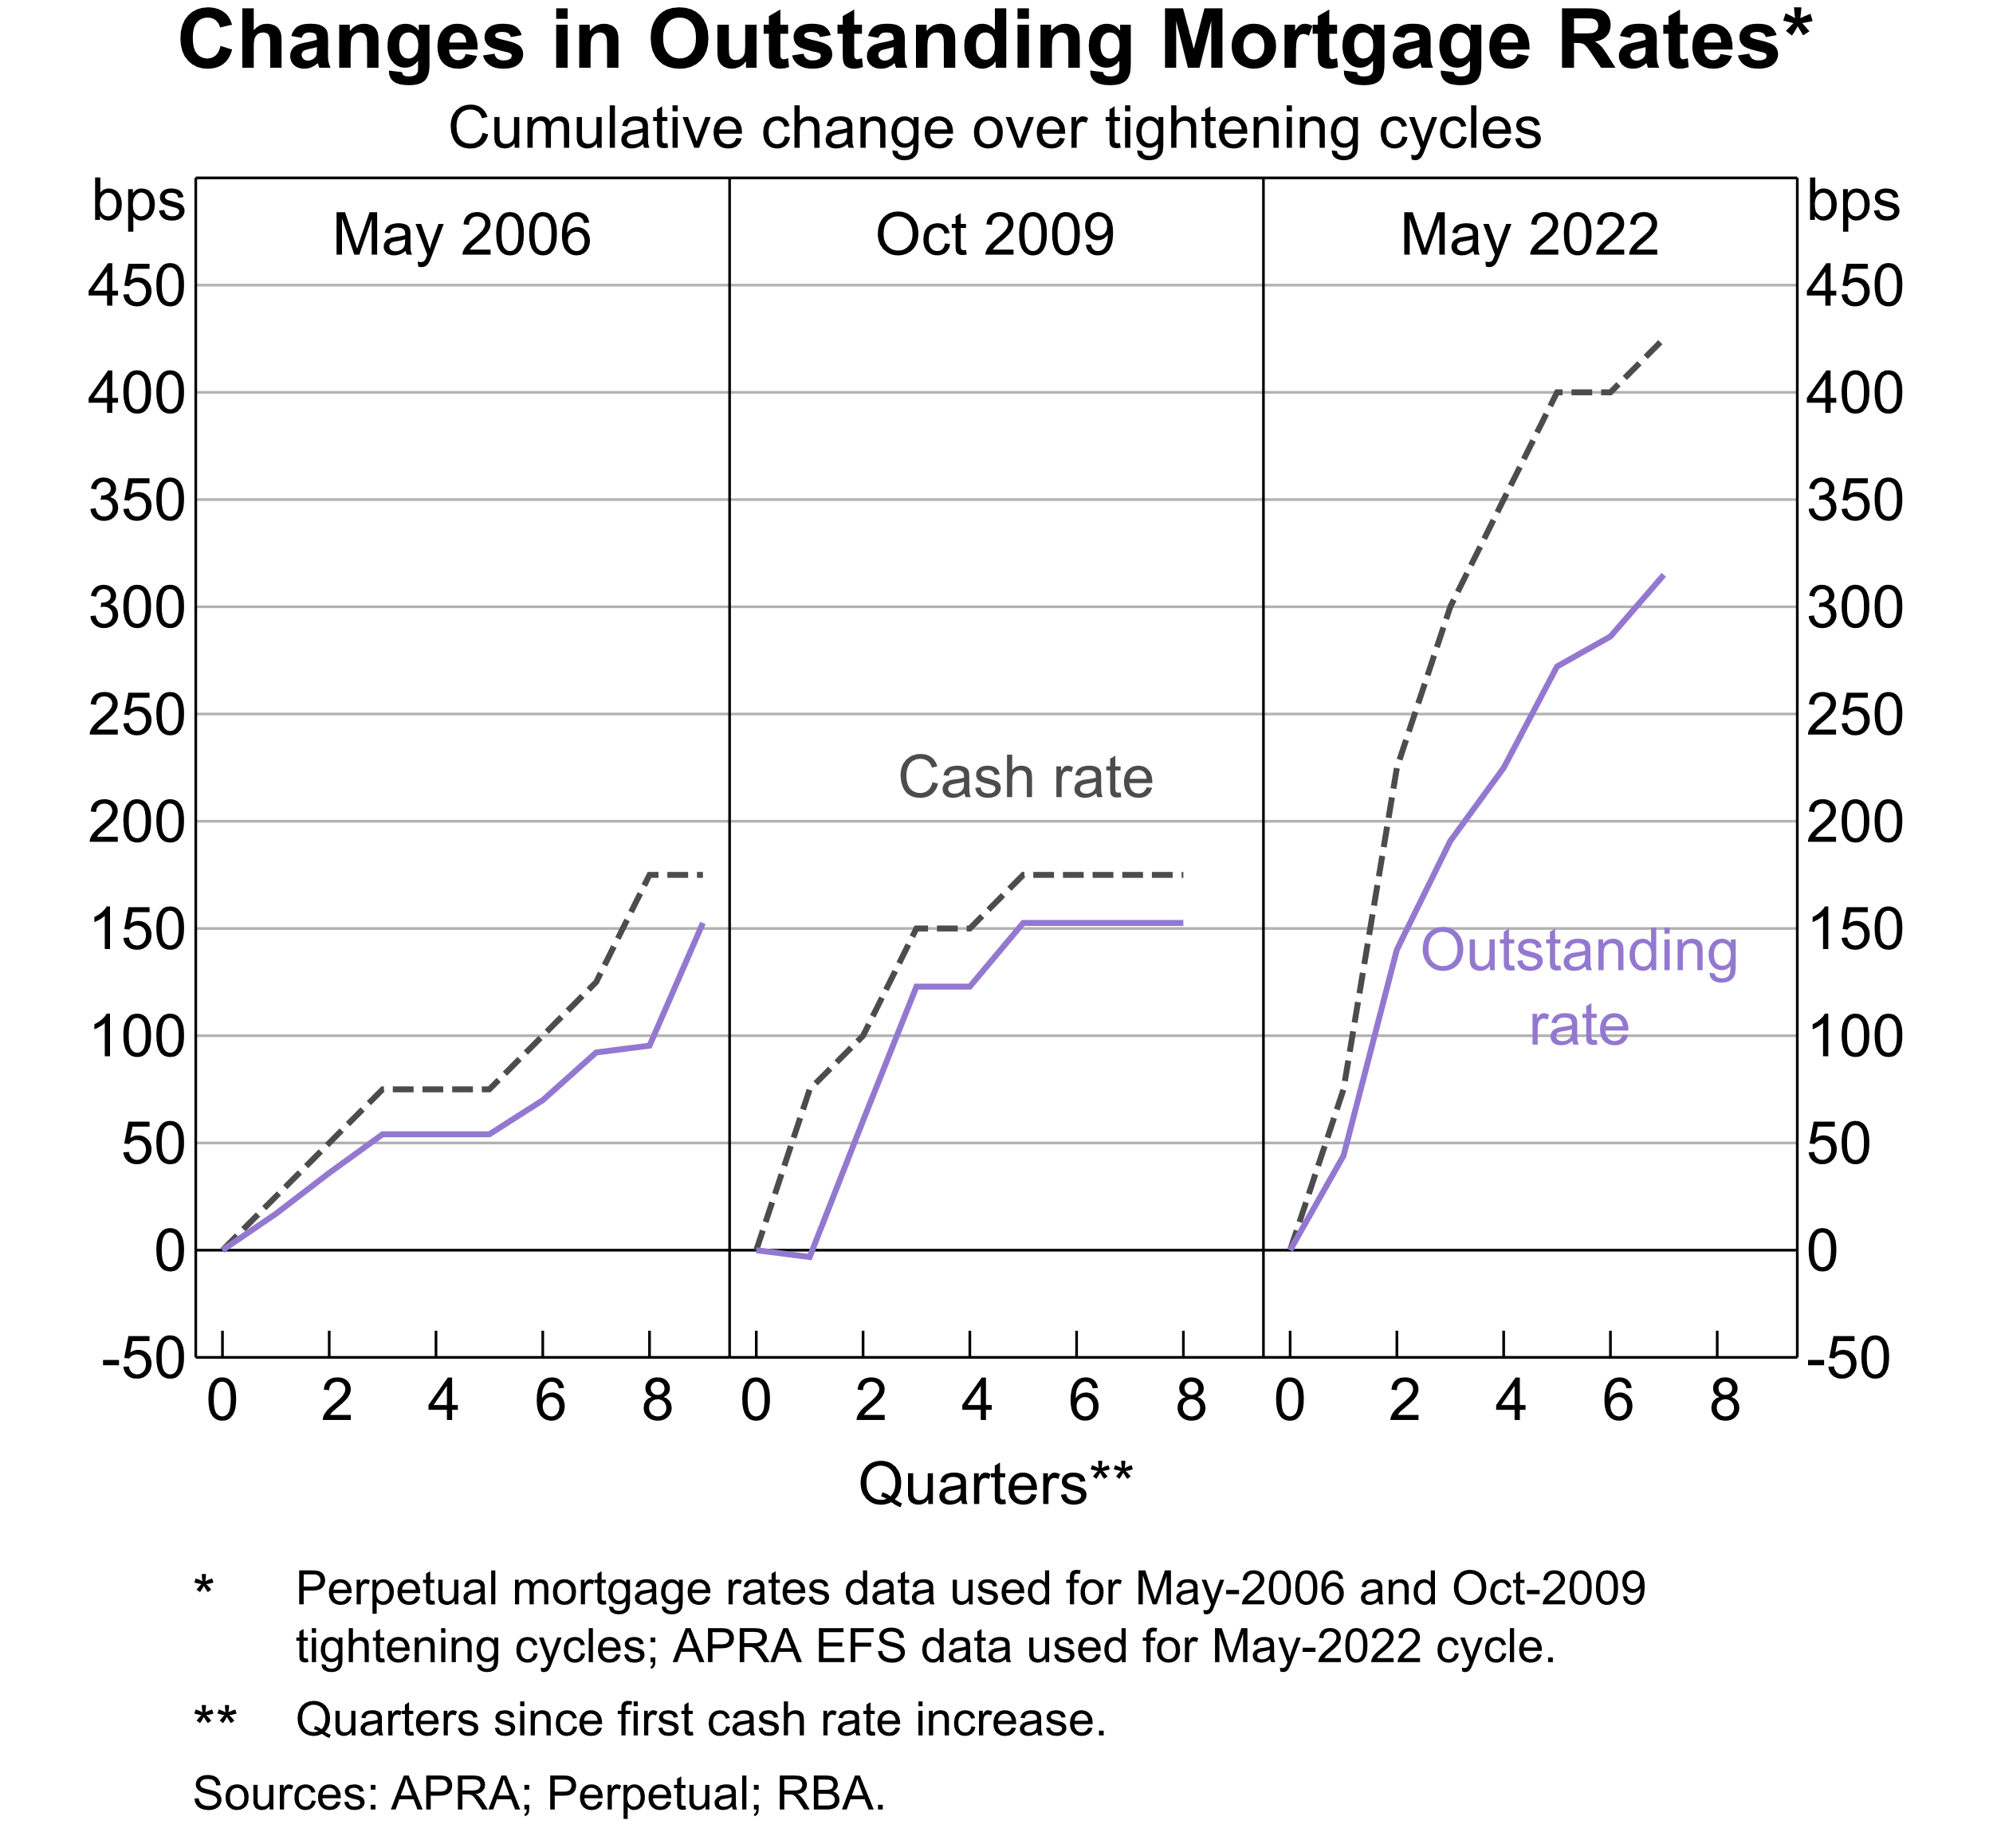

Slide 5
Outline
Fixed-rate loans have slowed the pass-through to outstanding mortgage rates.
Lending competition has also dampened pass-through to outstanding variable rates.
Pass-through to housing mortgage rates has still been an effective transmission channel for monetary policy.

Slide 6
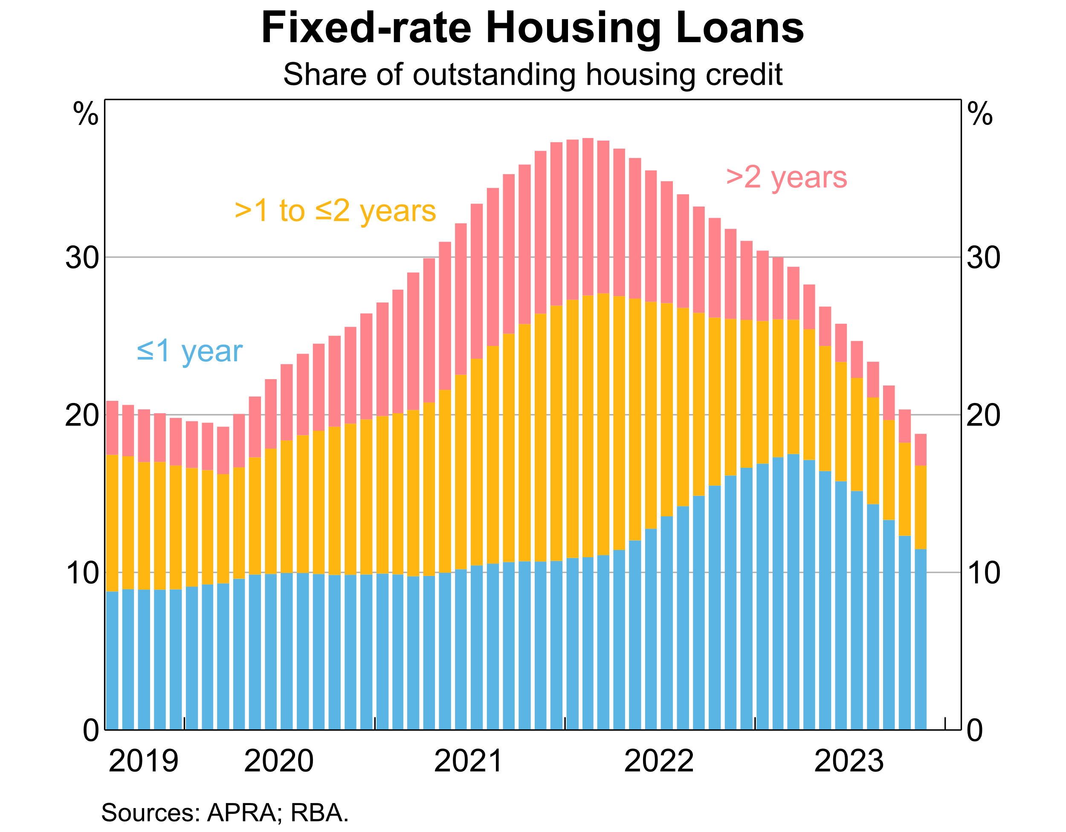

Slide 7
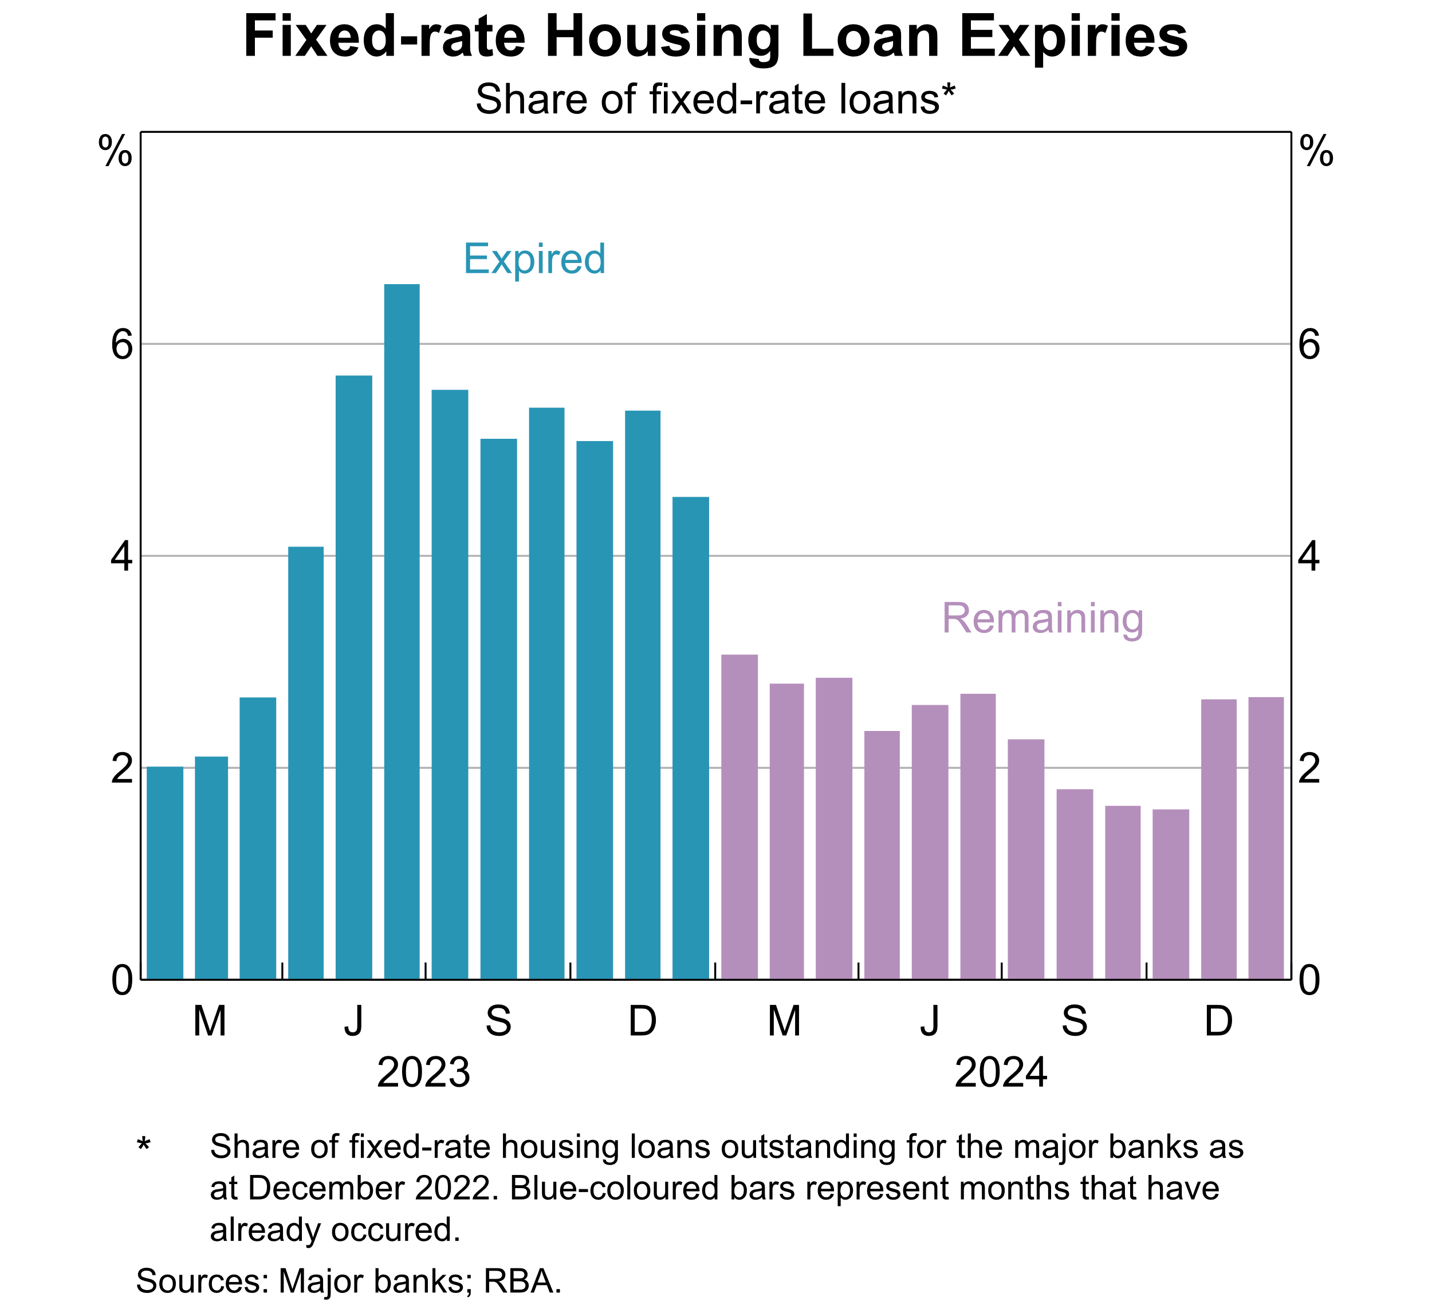

Slide 8
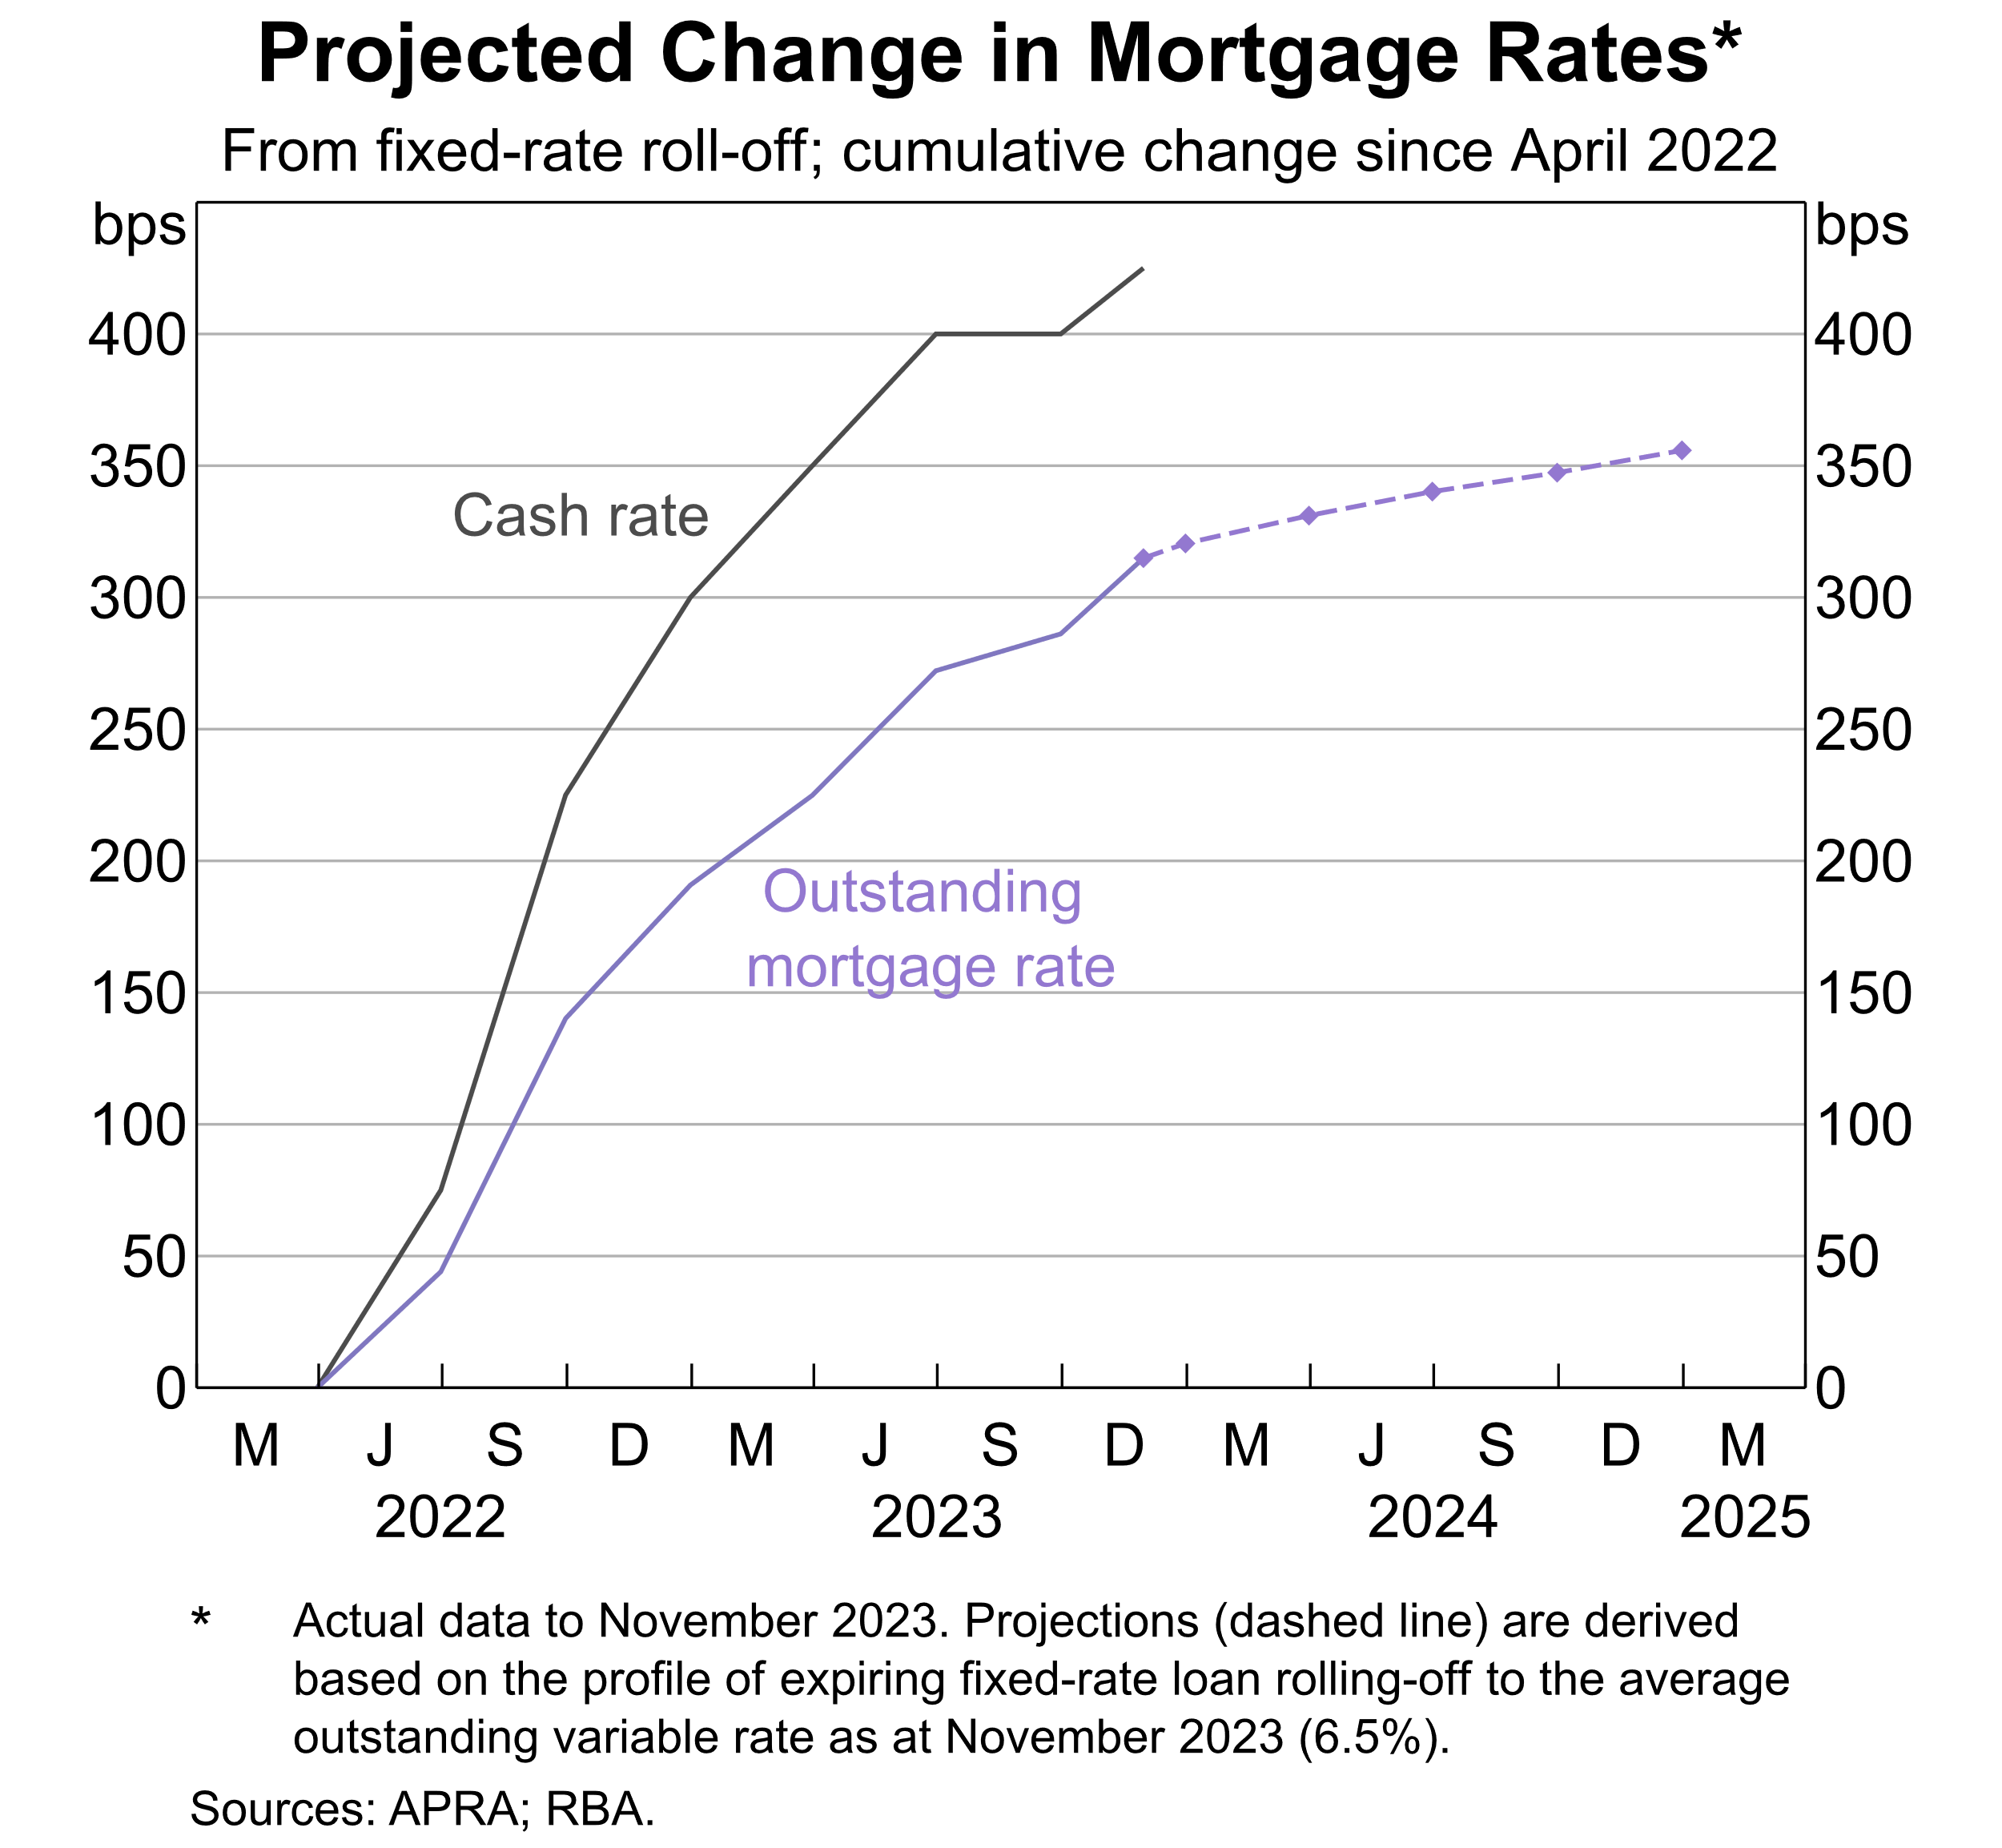

Slide 9
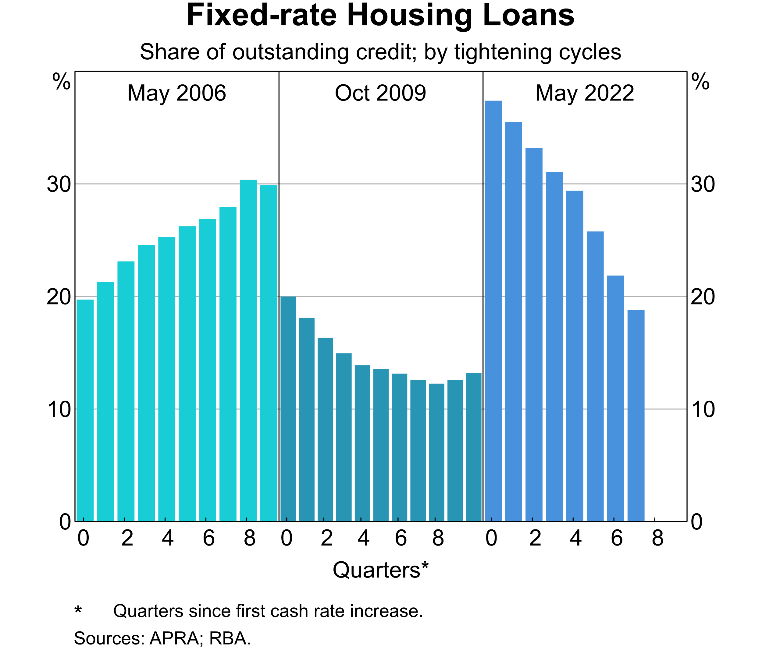

Slide 10
Outline
Fixed-rate loans have slowed the pass-through to outstanding mortgage rates.
Lending competition has also dampened pass-through to outstanding variable rates.
Pass-through to housing mortgage rates has still been an effective transmission channel for monetary policy.

Slide 11
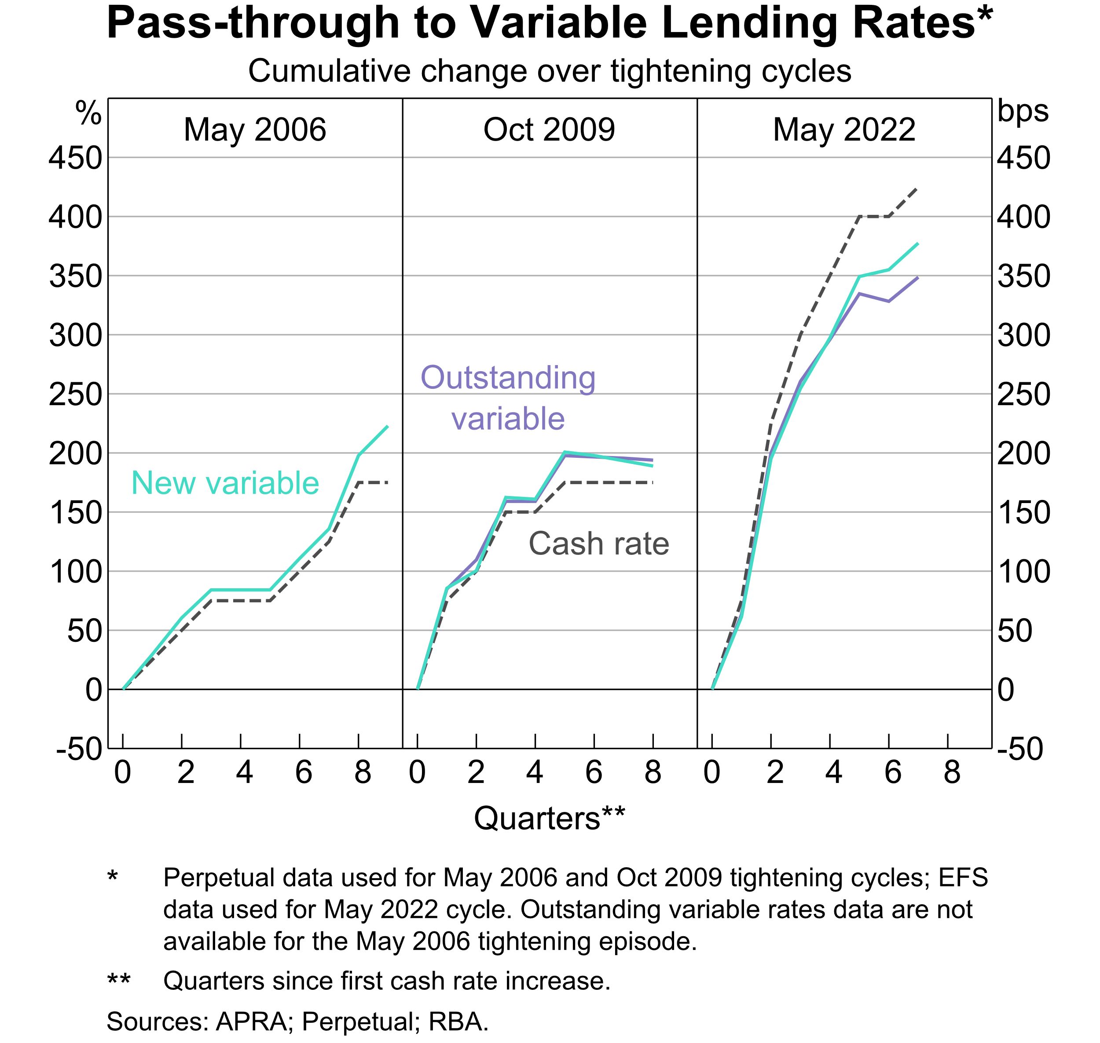

Slide 13
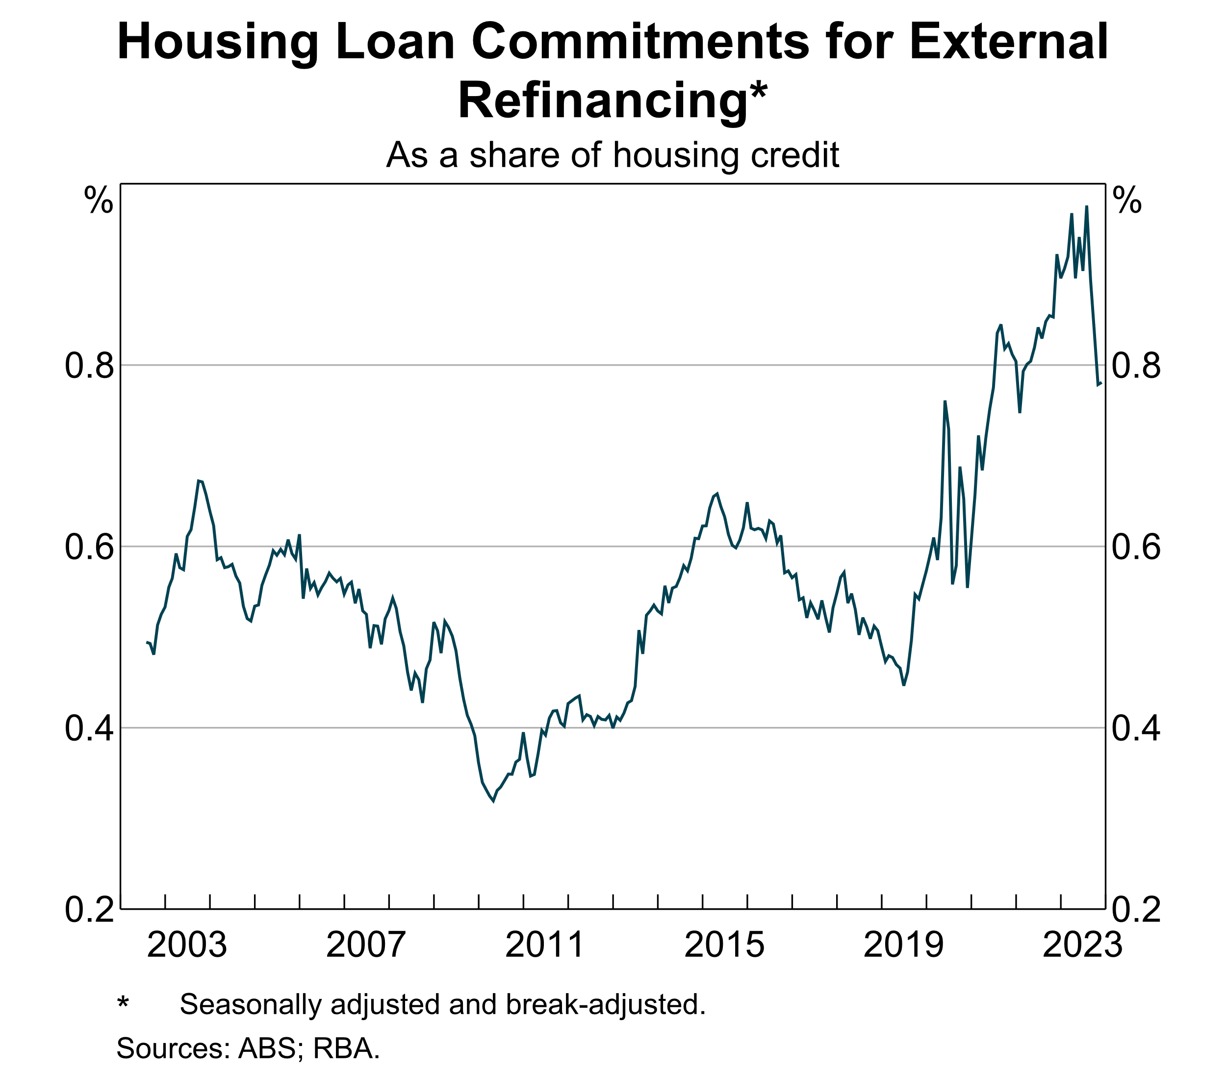

Slide 14
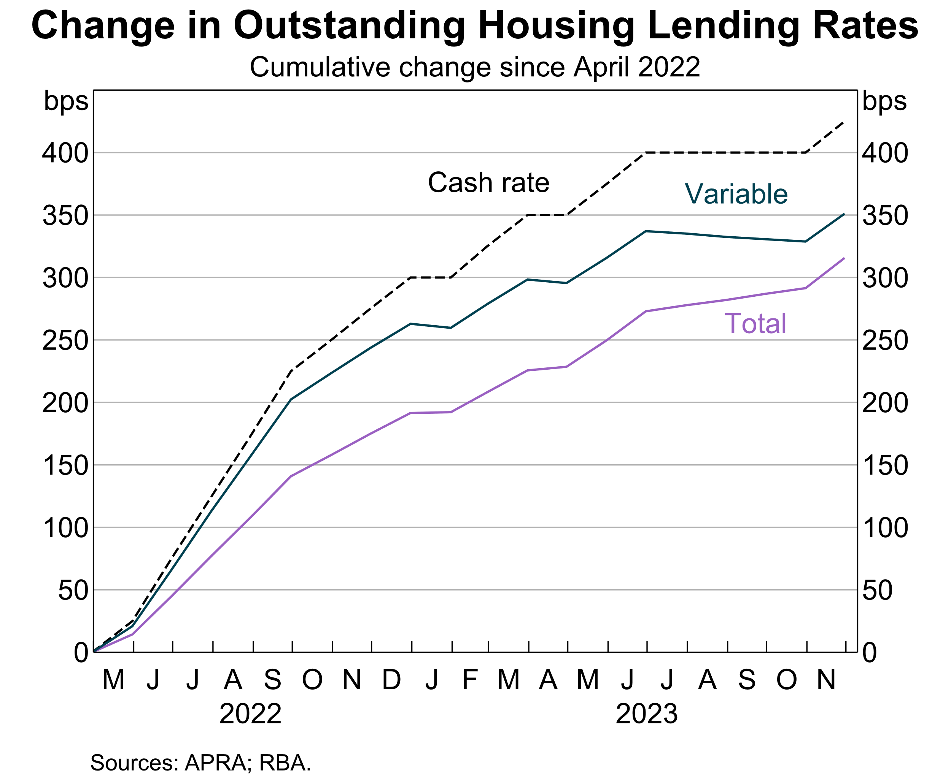

Slide 15
Outline
Fixed-rate loans have slowed the pass-through to outstanding mortgage rates.
Lending competition has also dampened pass-through to outstanding variable rates.
Pass-through to housing mortgage rates has still been an effective transmission channel for monetary policy.

Slide 16
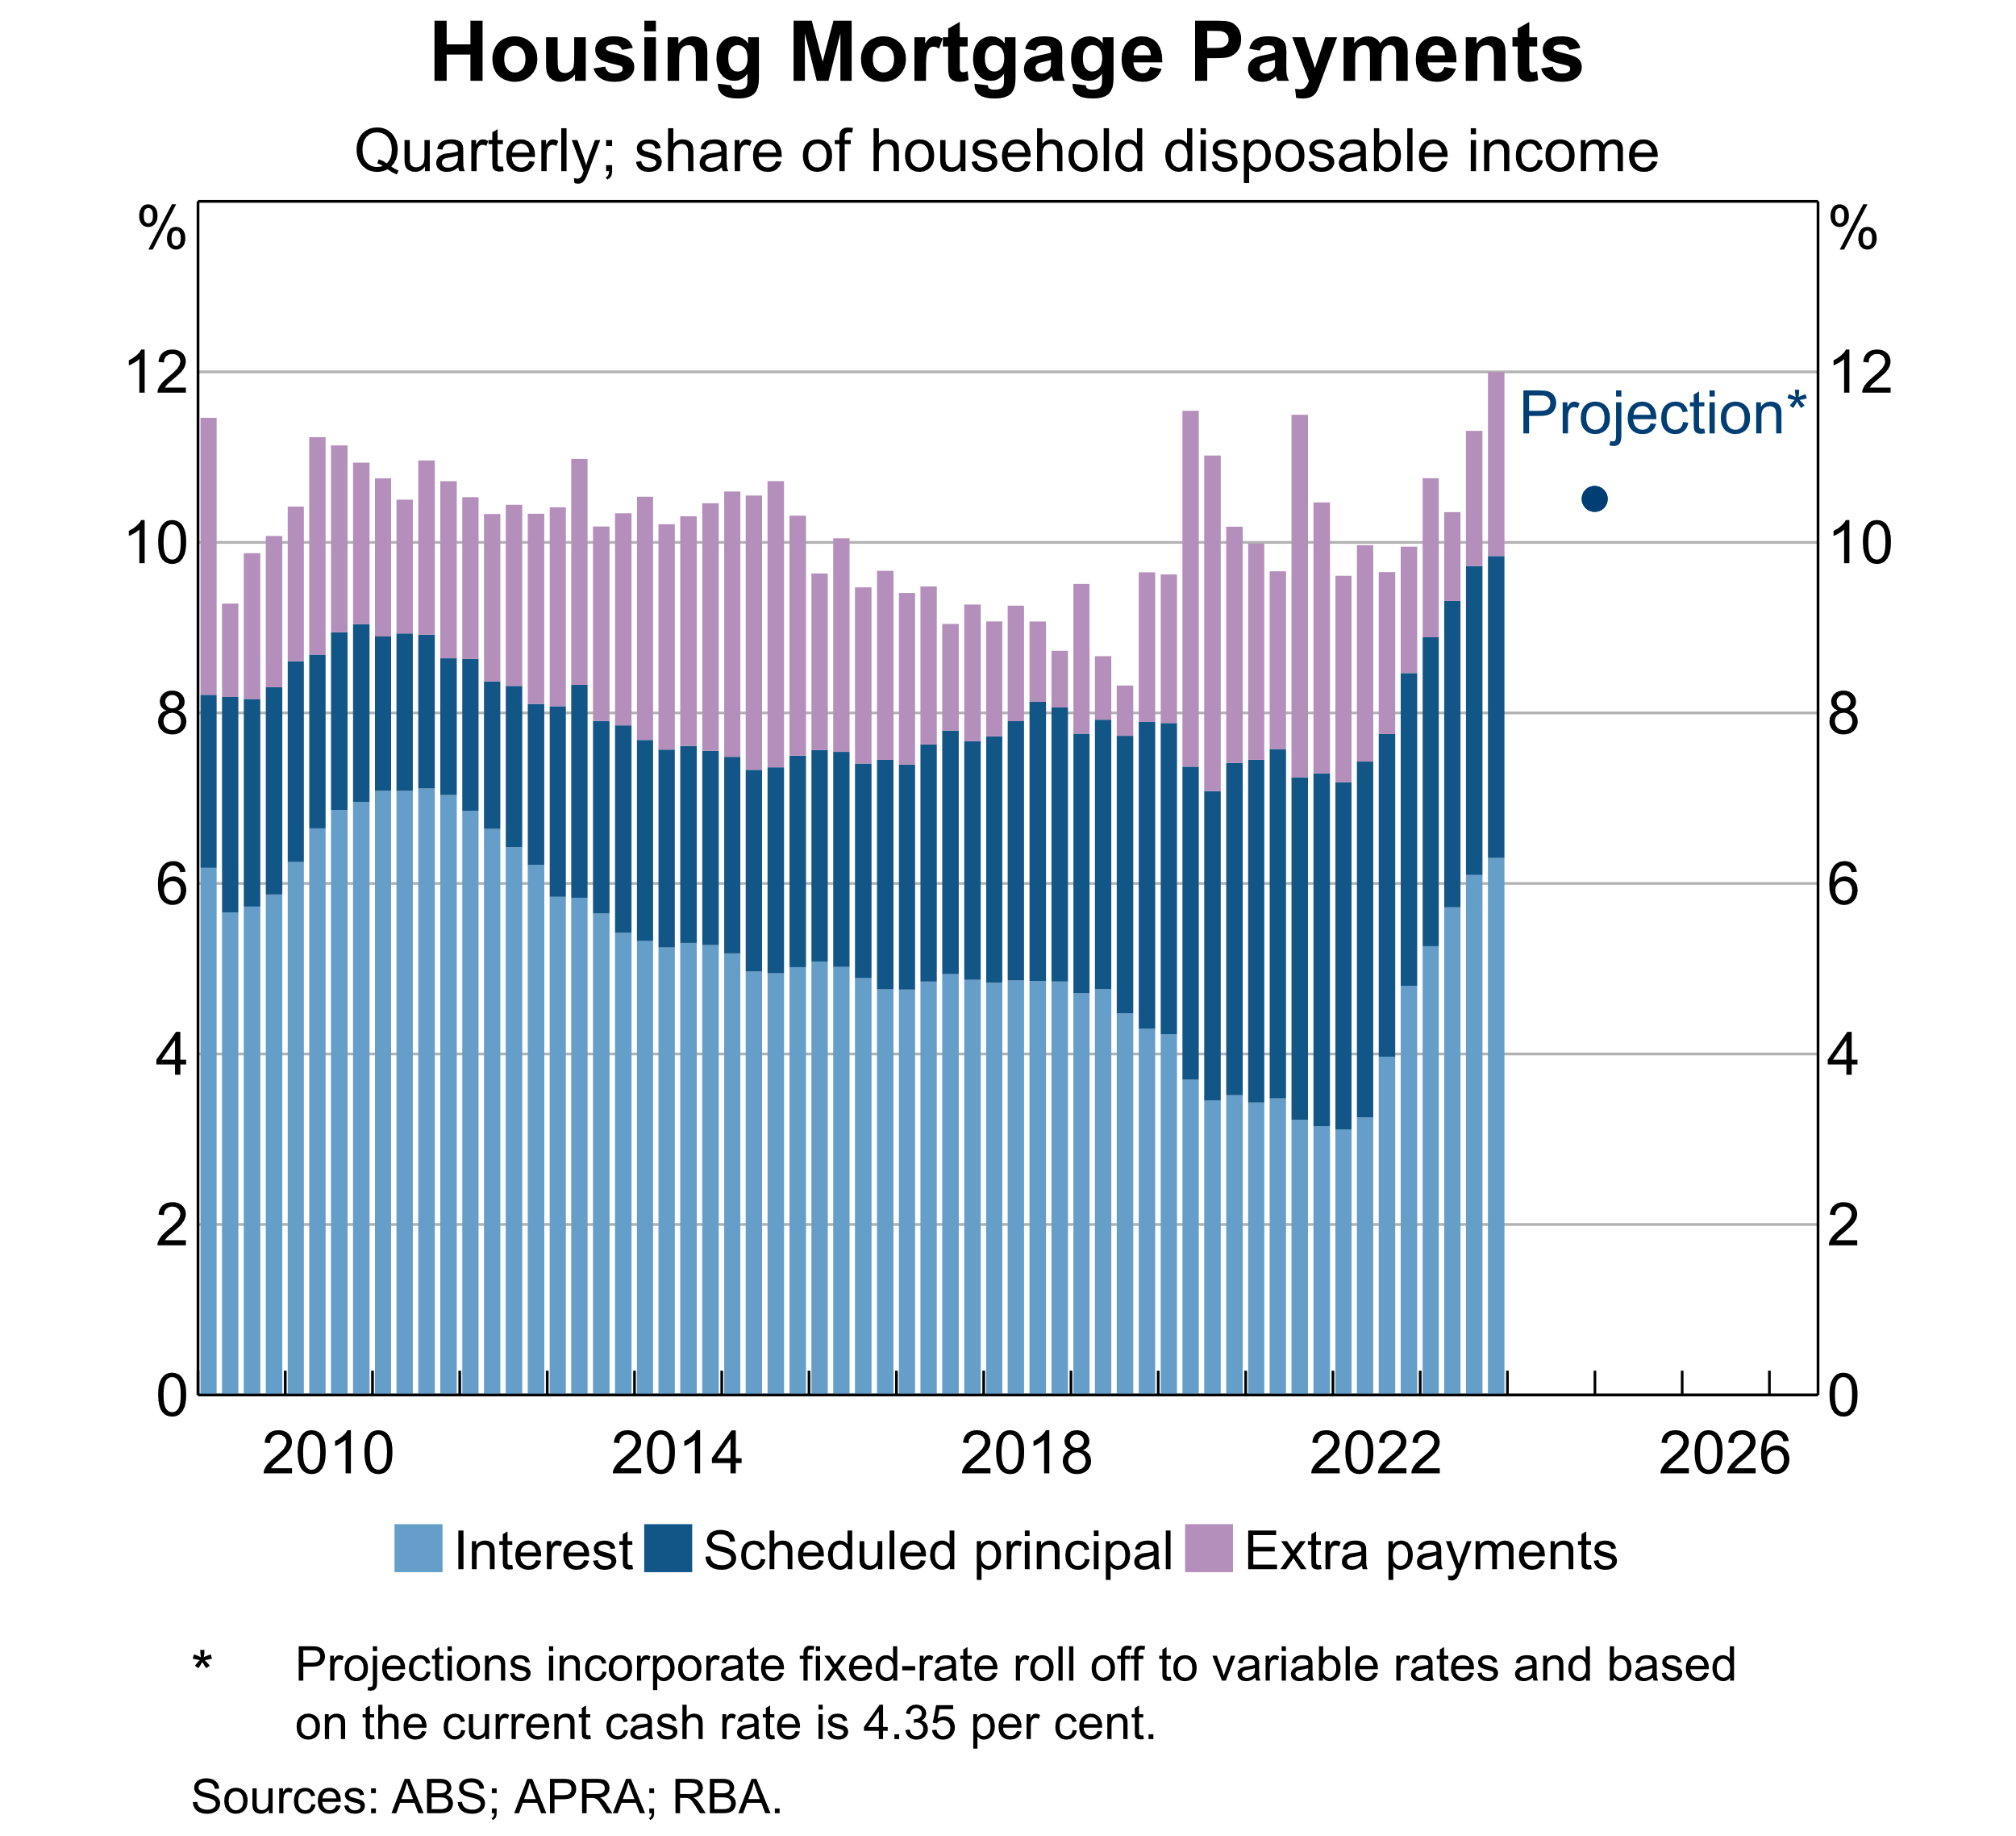

Slide 17
Takeaways
Slower pass-through to outstanding mortgage rates
Outstanding fixed-rate loans
Effect of lending mortgage competition
Pass-through to outstanding mortgage rates is still expected to reach similar proportions as prior hiking phases by end-2024.
The cash flow channel has still been strong over the current hiking phase.

Slide 18
Spares

Slide 19
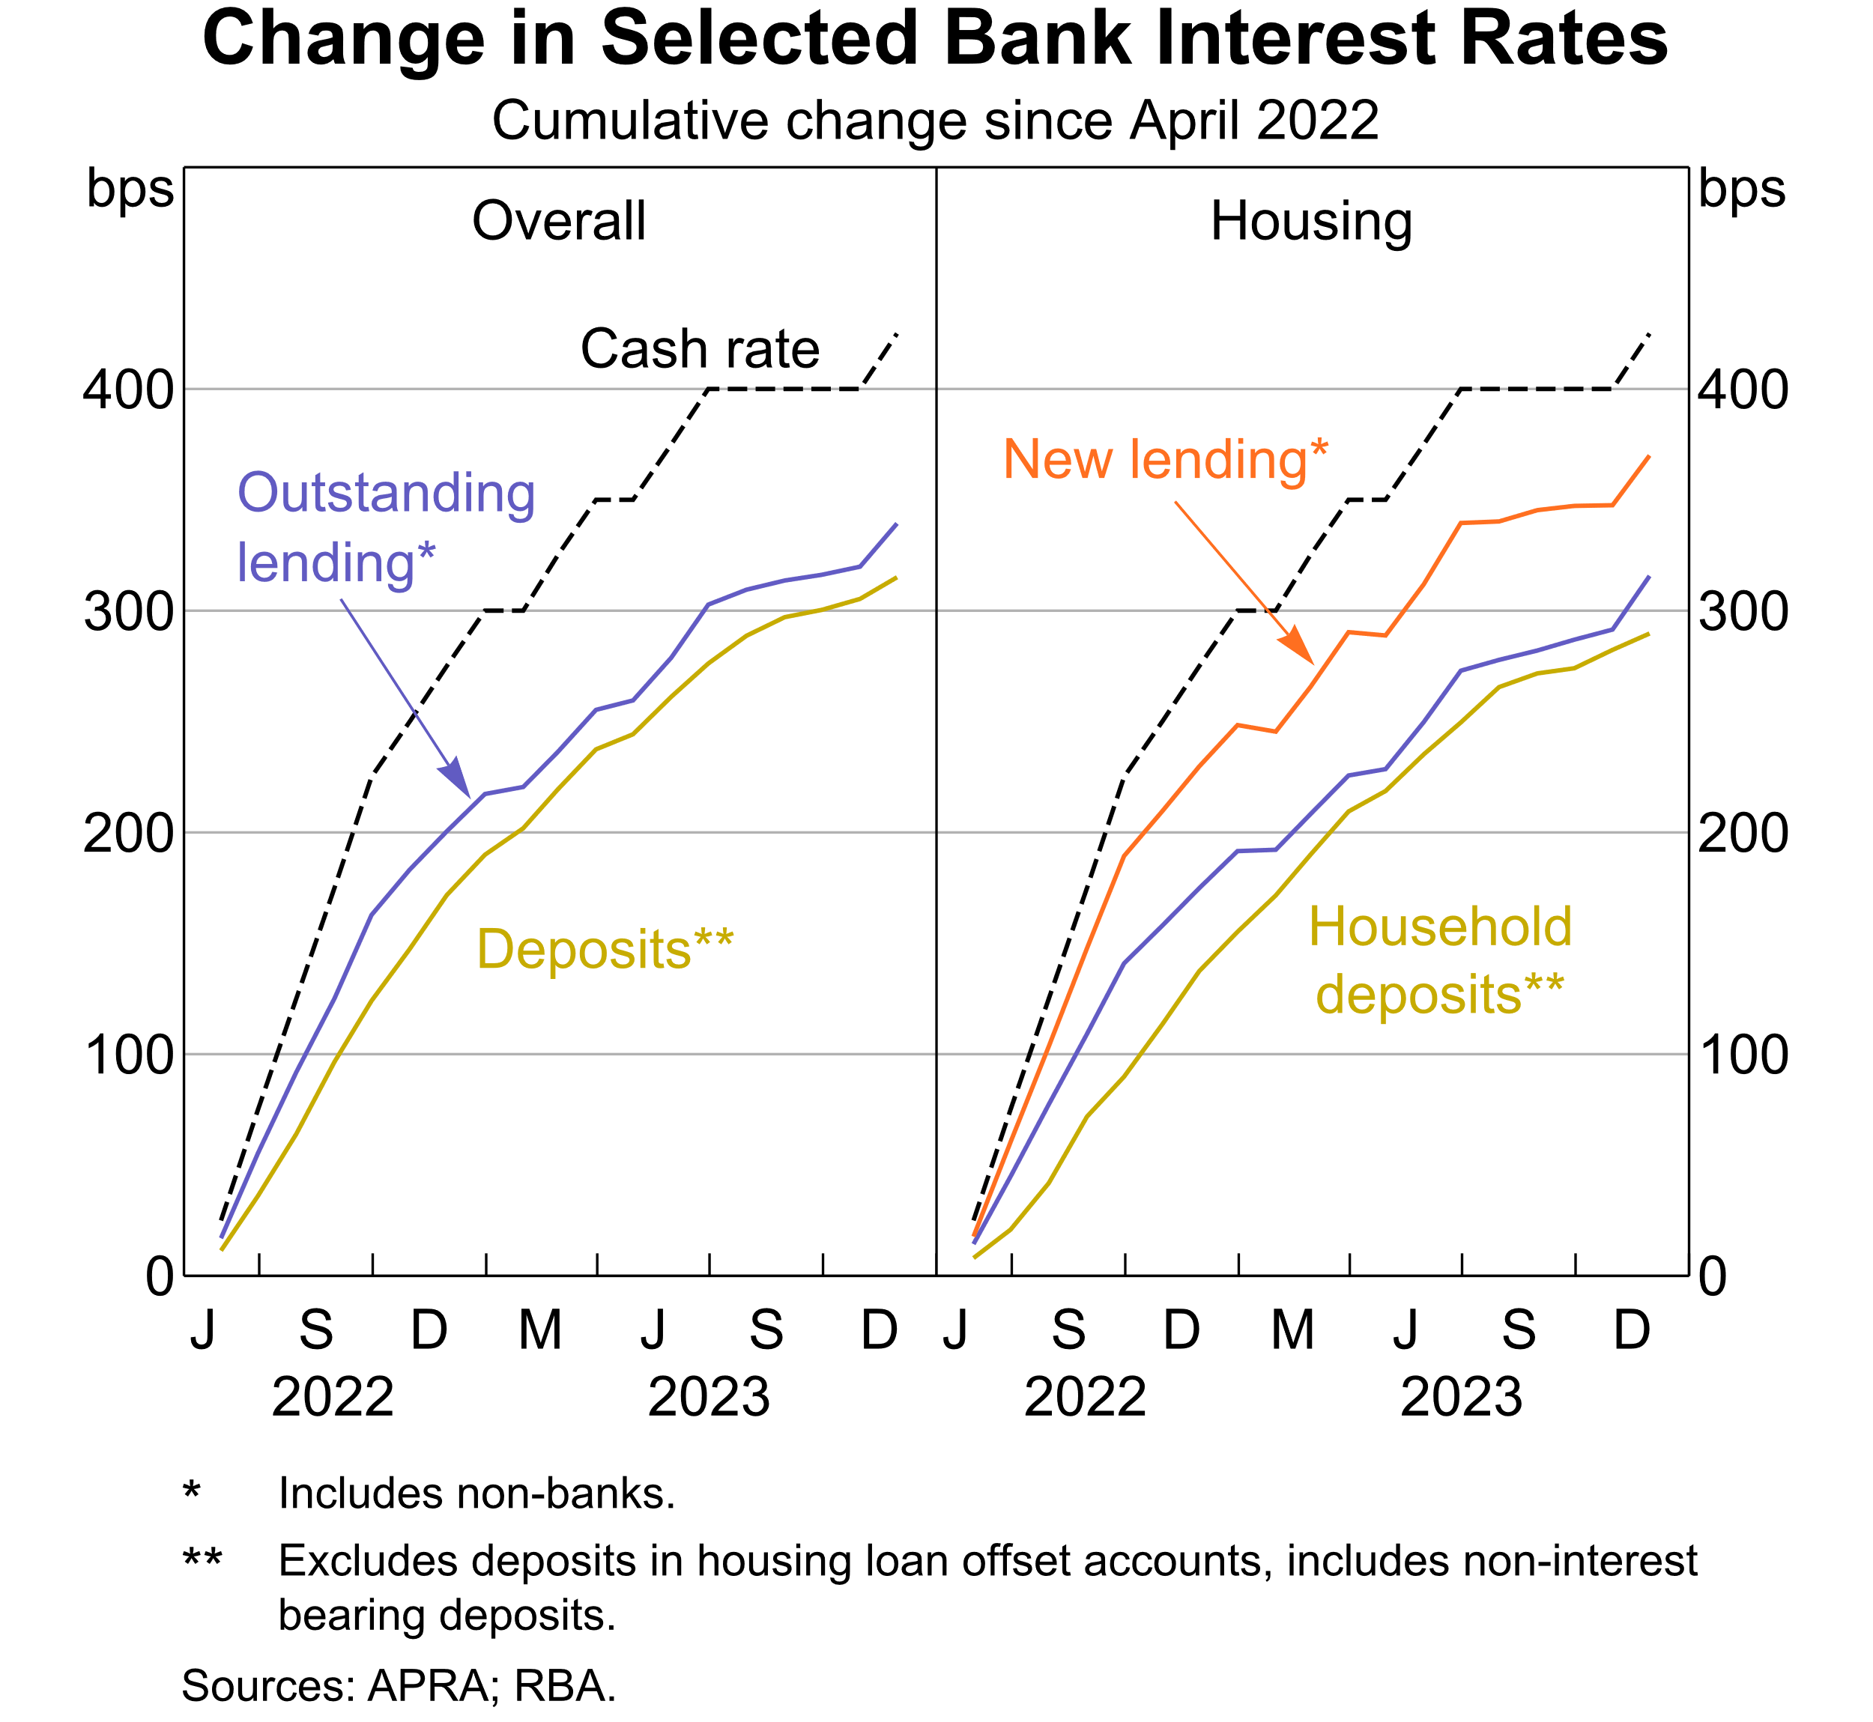

Slide 20
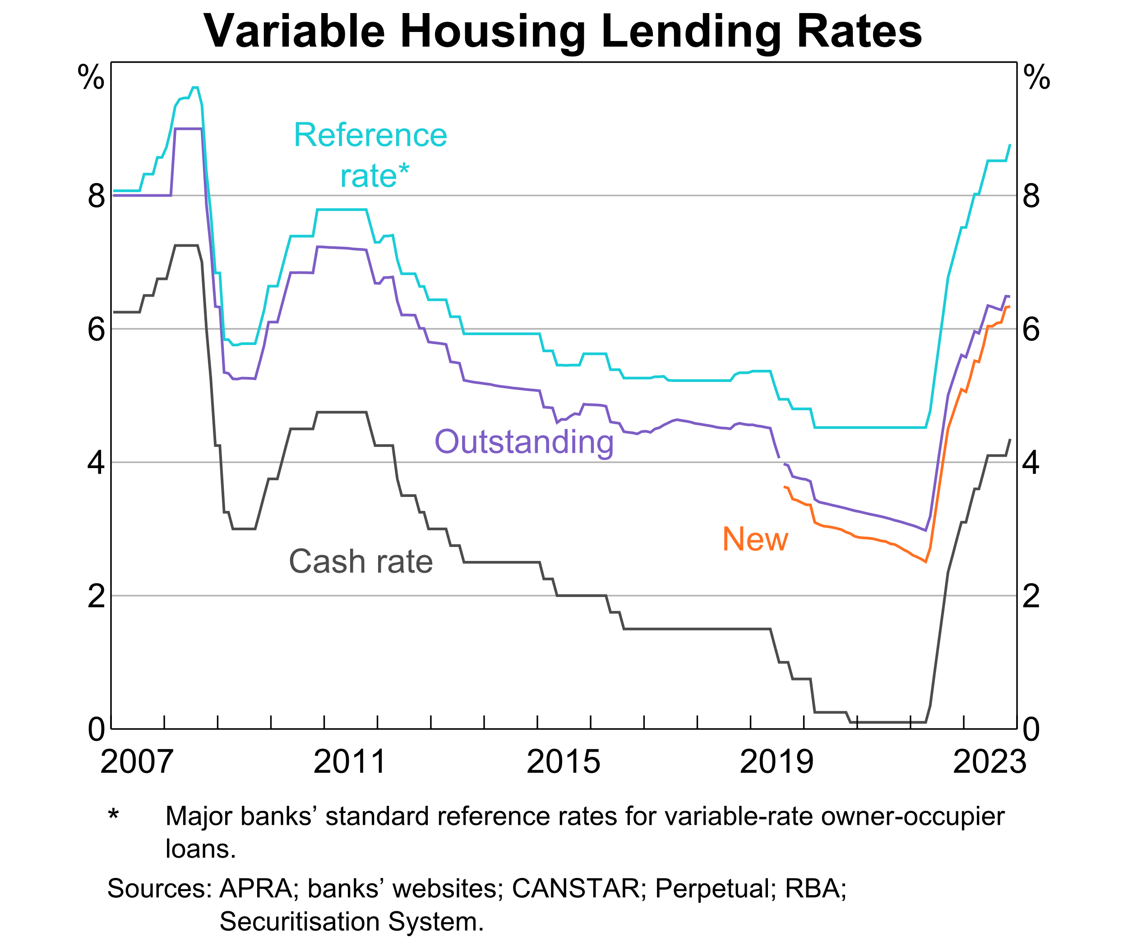

Slide 21
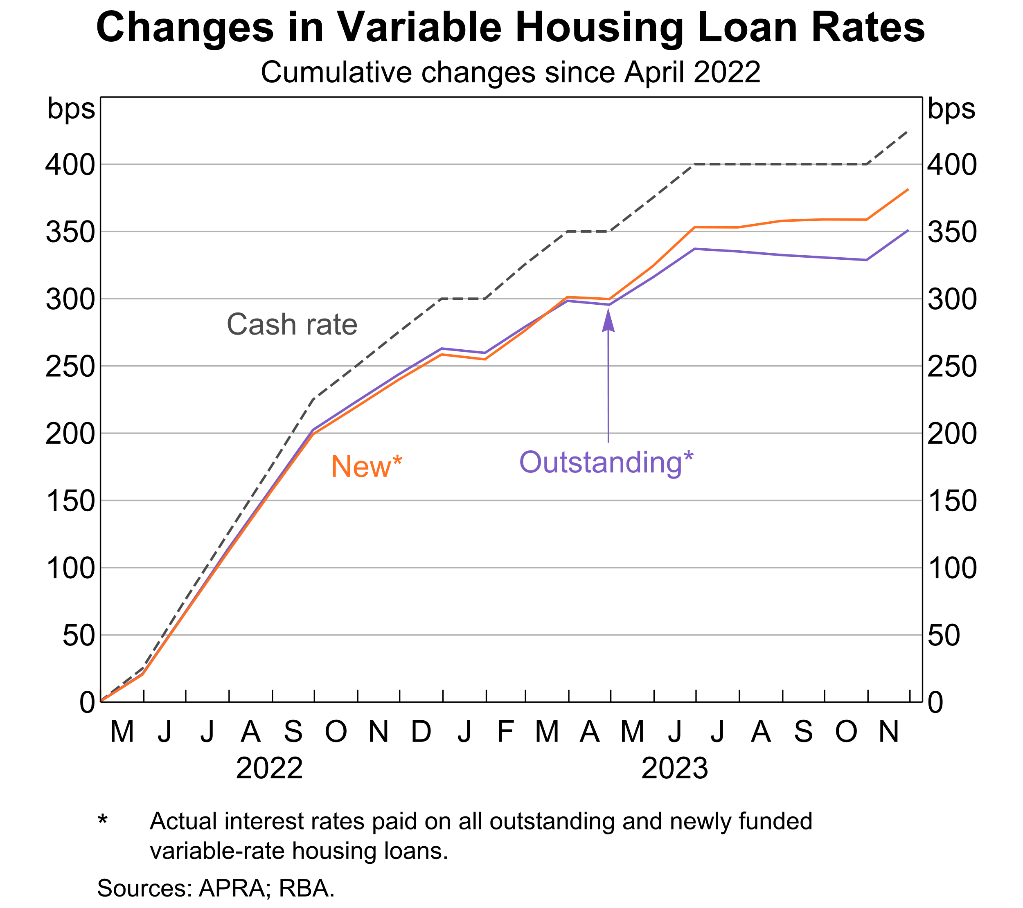

Slide 22
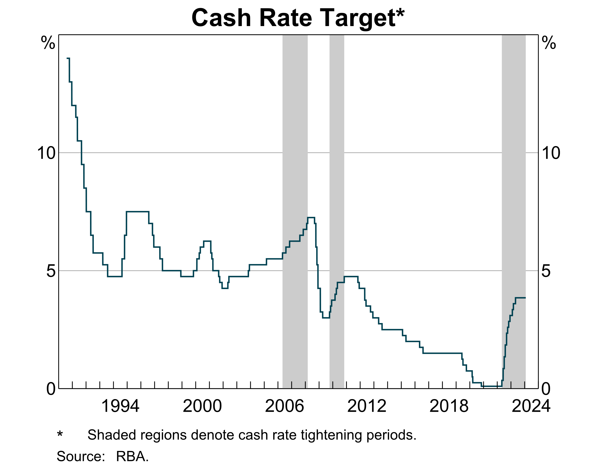

Slide 23
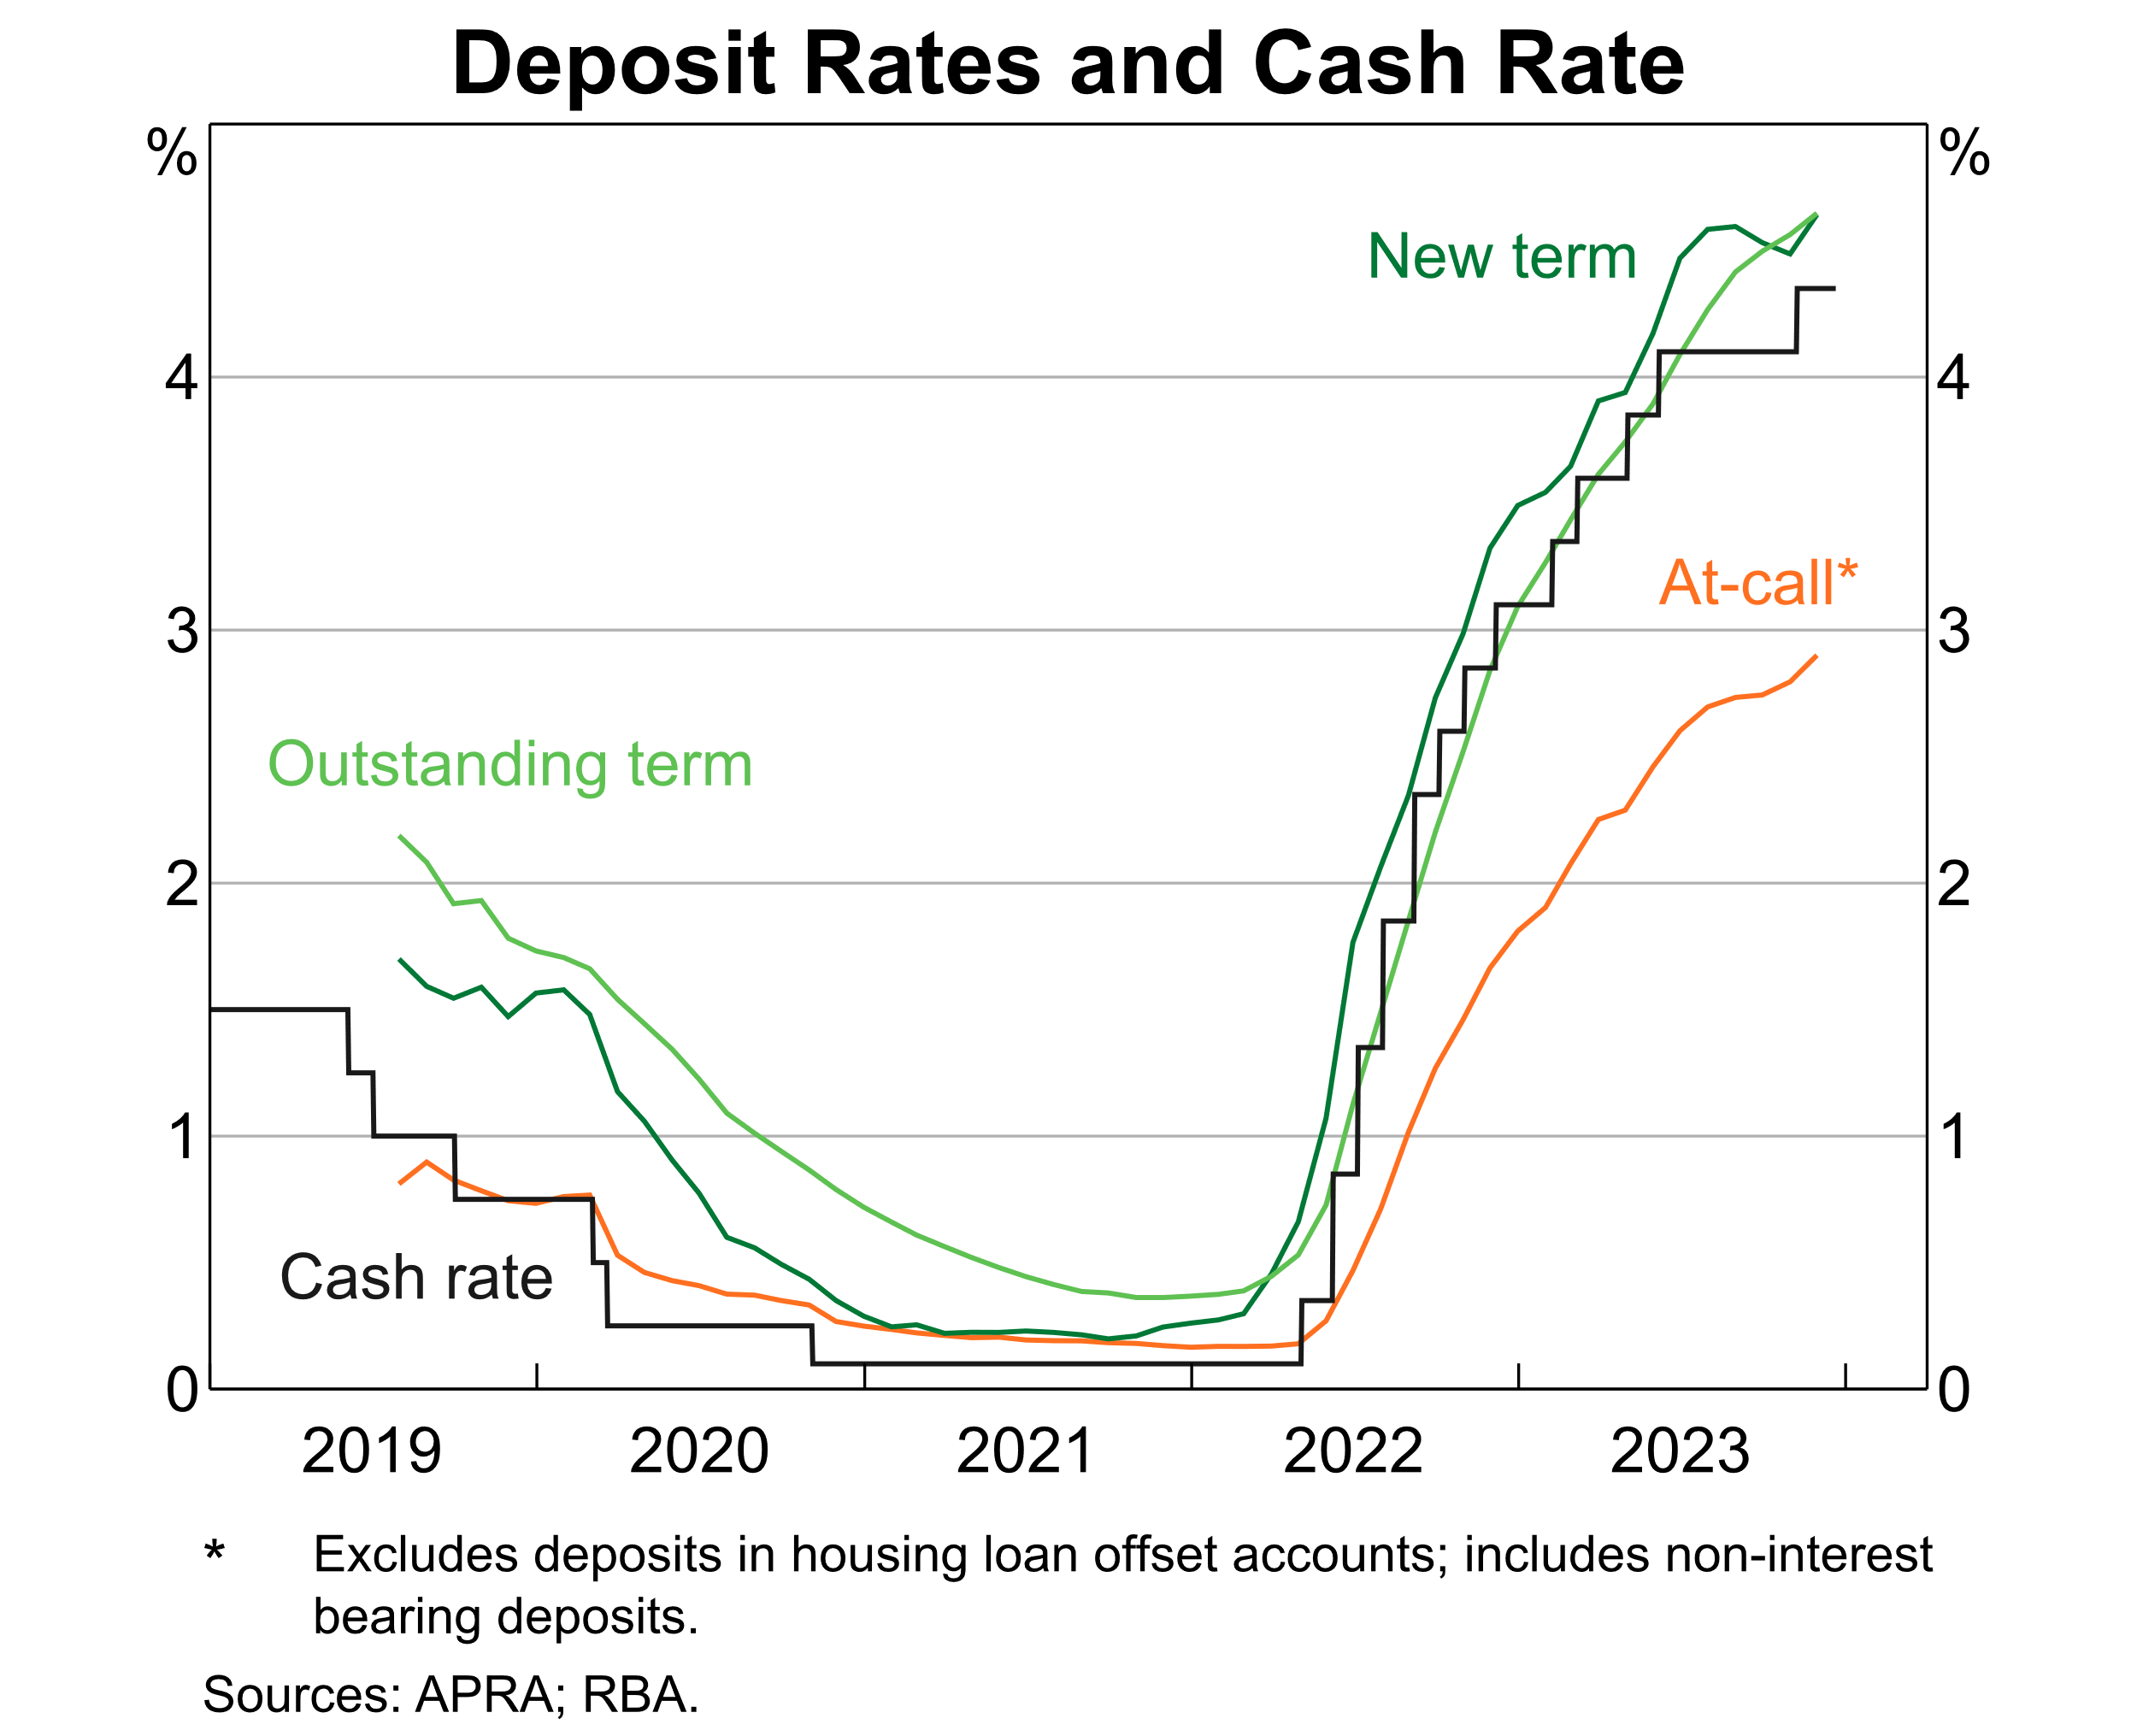

Slide 24
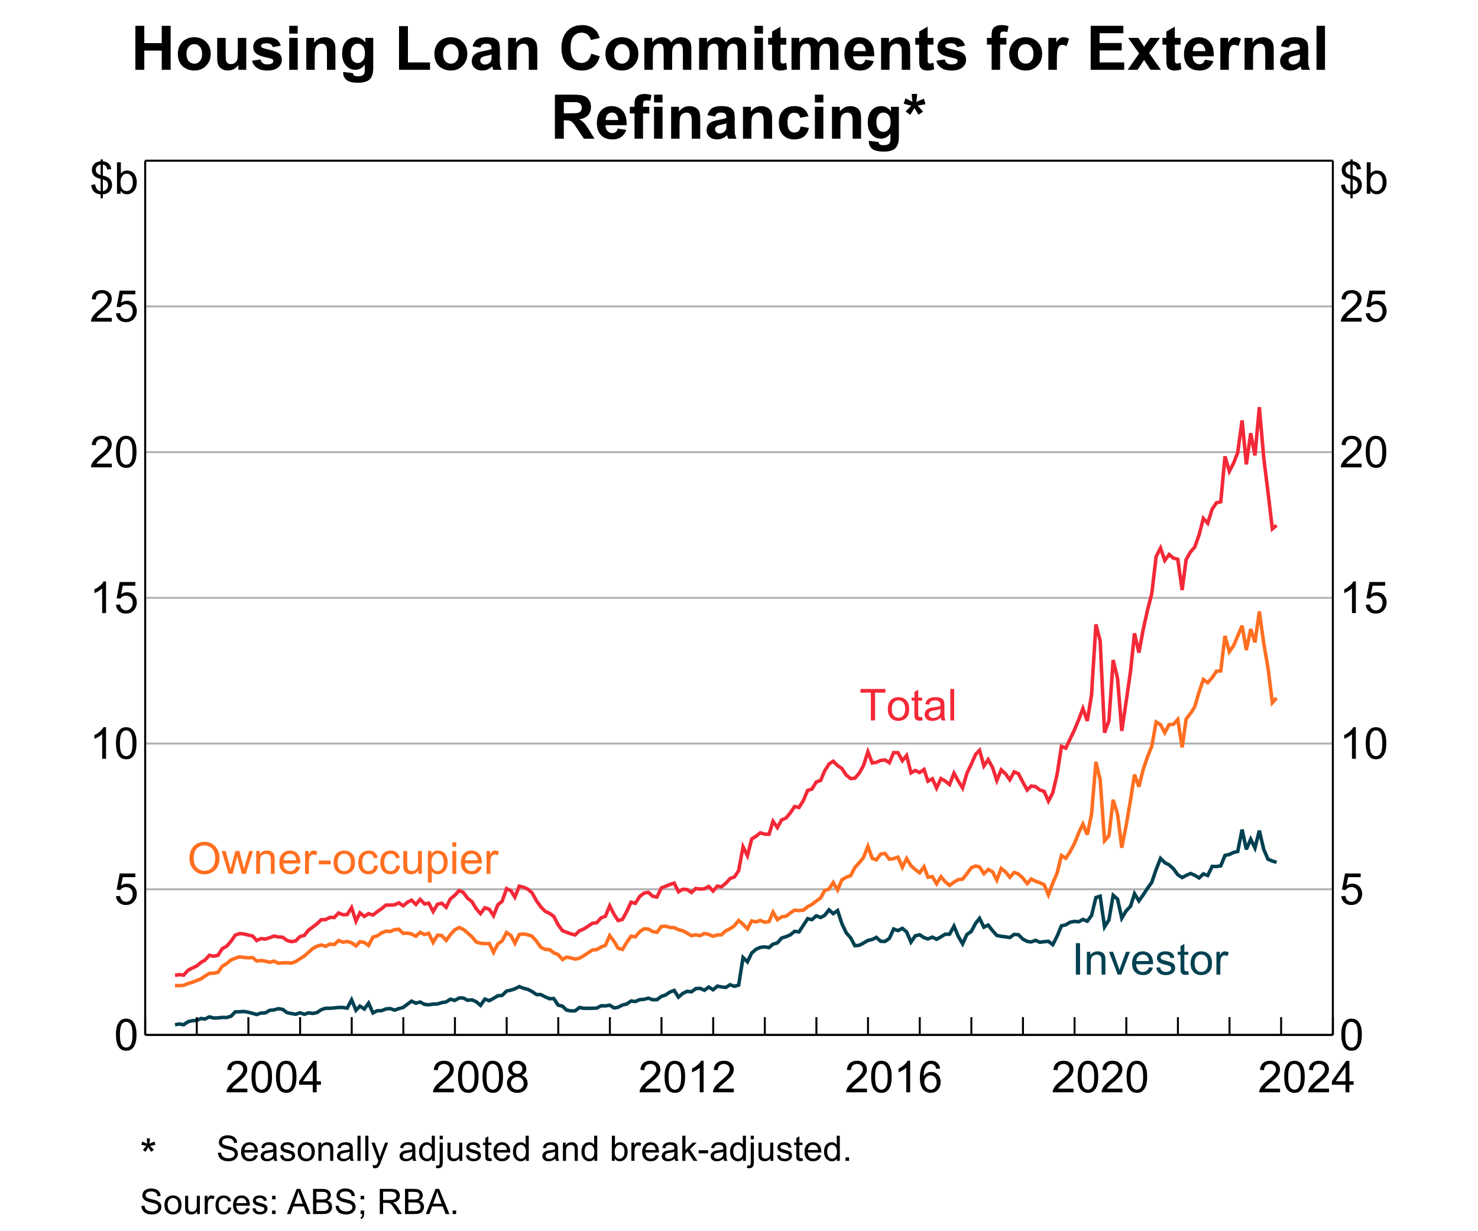

Slide 25
