Slide 1
Chose your parents wisely:
The rise, role and risks of the bank of mum and dad
Matt Lloyd-Cape, Director of the Centre for Equitable Housing, a Per Capita initiative
MMFC 2024

Slide 2
Background
www.housingmonitor.org.au
www.Centreforequitablehousing.org.au

Slide 3
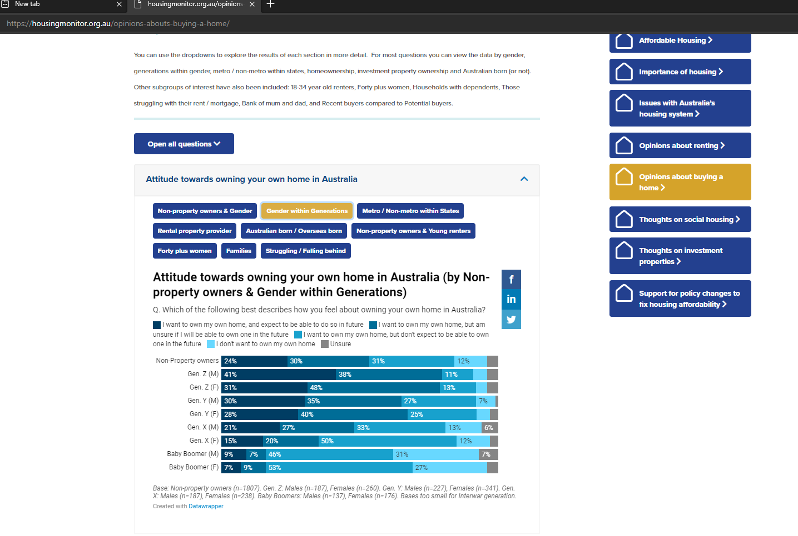
Background
www.housingmonitor.org.au
www.Centreforequitablehousing.org.au

Slide 4
The Rise of the BOMAD
Demographics
Urbanisation
Aging society
Large Boomer cohort
Delay in family formation
Changing govt housing priorities
Retreat from construction role
Reduced supply
Increased demand side spending
Changes to market structures/
incentives
Investor mortgage reforms
NG and CGT discount
Systemic changes to wealth distribution
Older housing wealth growth > youth housing wealth growth
Net wealth of renters < OOs

Slide 5
The Rise (TL:DR) Growing housing wealth inequality as cause and effect of the BOMAD The BOMAD is a private response to a social failure
Rising house prices
Rising housing wealth inequality
Growth in need for and capacity of BOMAD

Slide 6
The role of the BOMAD
Financial gifts
Conditions loans
Guarantor
In-kind assistance
01
02
03
04

Slide 7
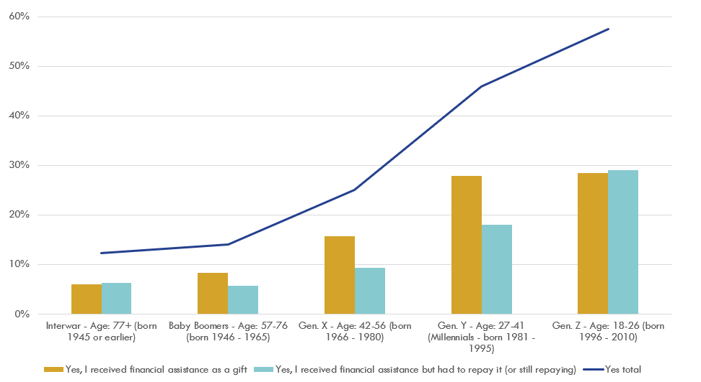
Incidence of BOMAD transfers Did you receive any assistance from your family or your partner's family when you purchased your first house in Australia? By generation

Slide 8
Share of BOMAD activity by type and amount, percent
Source: Jarden

Slide 9
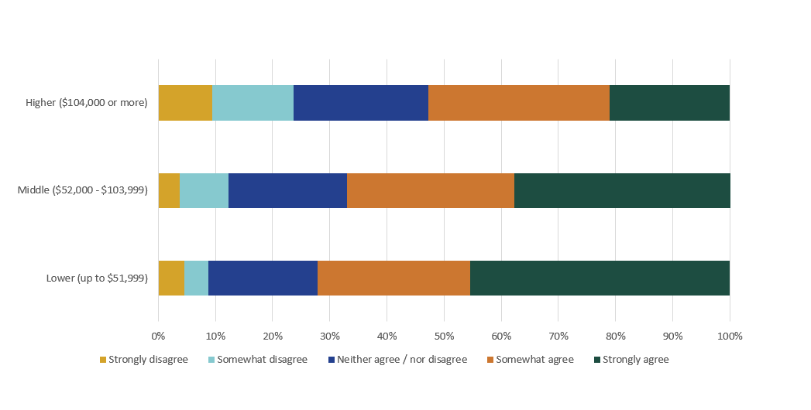
BOMAD expectations: The only way I'm ever likely to be able to own my own home is if I get a large inheritance. By individual income

Slide 10
In-kind assistance: the pa“rental” subsidy
Cohabitation or other free/subsidised accommodation
Overcome deposit hurdle
Wealth likely plays a role in capacity to provide in-kind
Significant effect, few studies
Rent free
26%
Renting
10%

Slide 11
The risks of the BOMAD
Intragenerational housing wealth gaps
Intergenerational housing wealth gaps
Replication of existing inequalities
Specific threat to Australia?
01
02
03
04

Slide 12
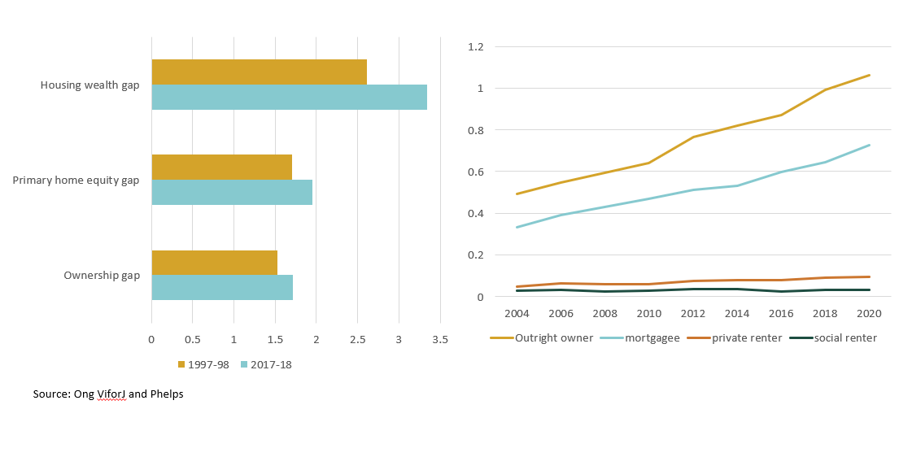
Housing wealth gap:
Ratio between 50-59-year-olds to 30-39-year-olds in 1997/98 and 2017/18
Net wealth by tenure type, median, $m

Slide 13
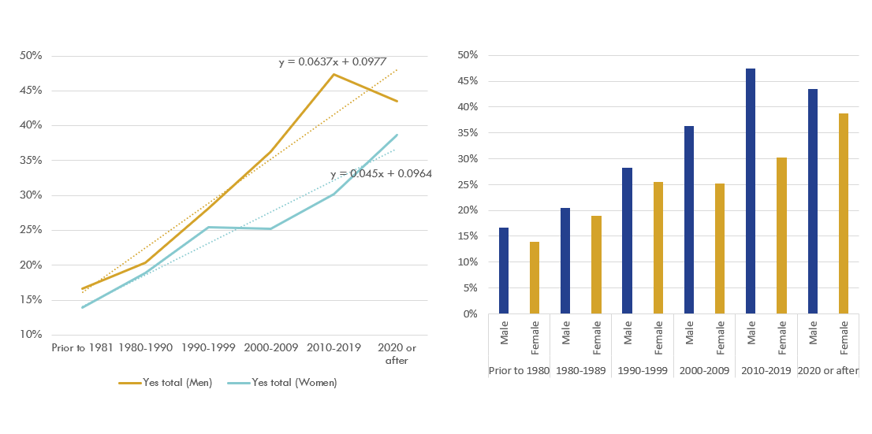
Did you receive any assistance from your family or your partner's family when you purchased your first house in Australia?
Gender and decade of purchase

Slide 14
Conclusions and policy implications
Wealth is back, and it is back in the housing market most clearly
The BOMAD is a household level response to a societal failure of housing policy
Contains risks and will amplify existing inequalities
Out of step with national self-image, and reliance on migration
Wealth tax/capital transfer tax?
CGT and negative gearing reform more realistic
Reforms to government supply policies
Targeted shared equity/loan guarantee programs
What questions and factors should we include in our future surveys?

Slide 15
Matt Lloyd-Cape
0468 321 799
m.lloyd-cape@percapita.org.au
Centreforequitablehousing.org.au

Slide 16
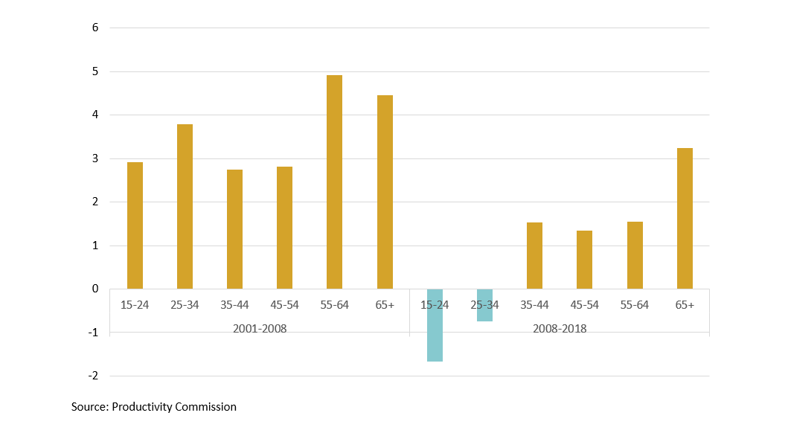
Income growth (and decline) %

Slide 17
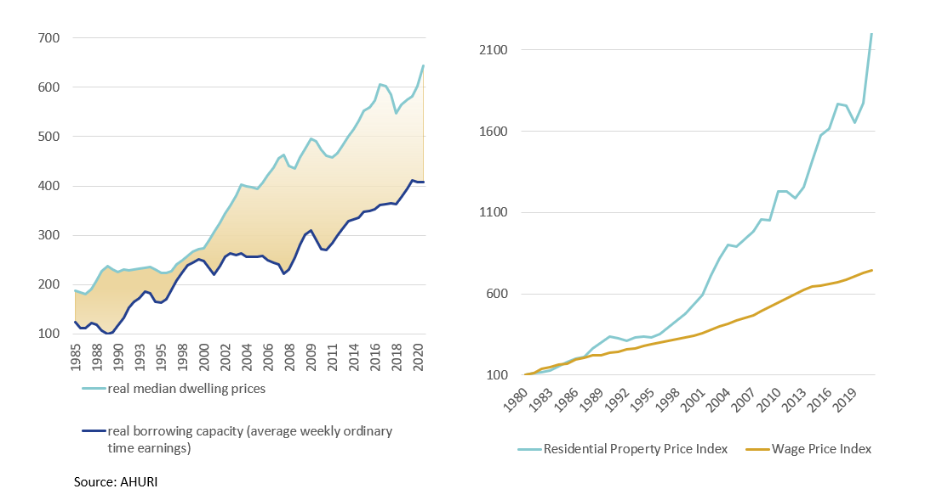
Rising prices and declining borrowing capacity

Slide 18
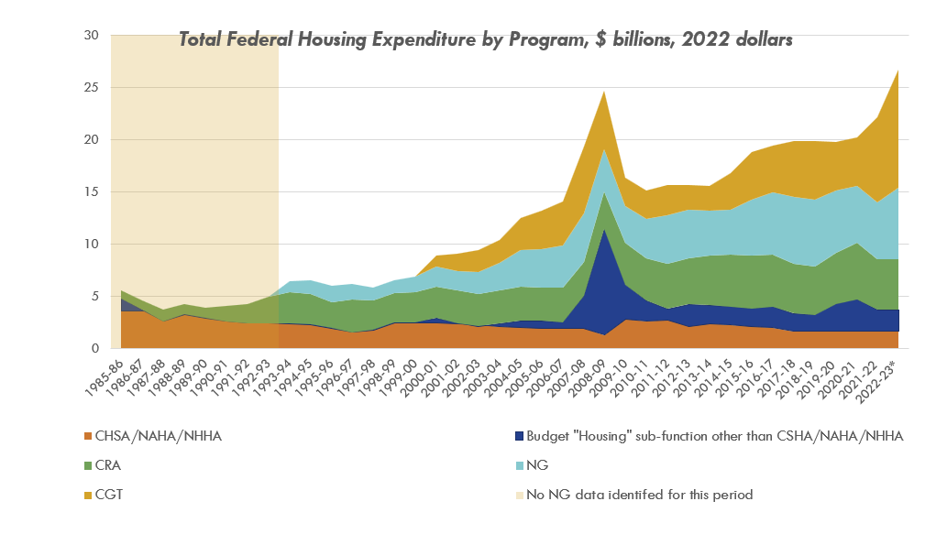
The Rise of the BOMAD: Shifting Federal Priorities

Slide 19
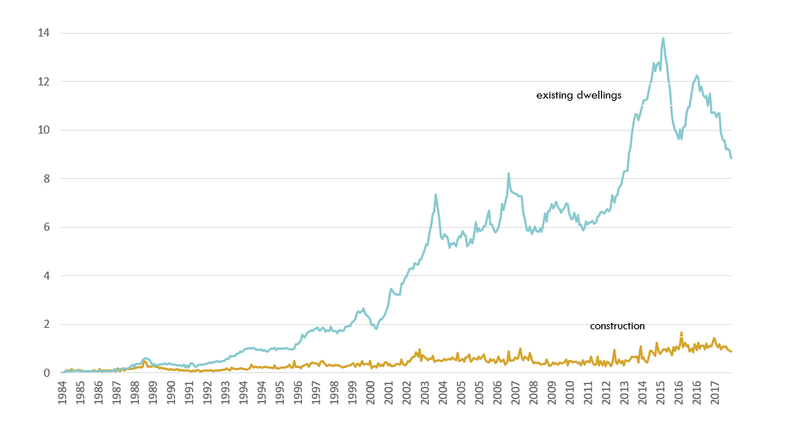
Shift in investment type

Slide 20
Net overseas migration and natural rate of increase, quarterly, 000s

Slide 21
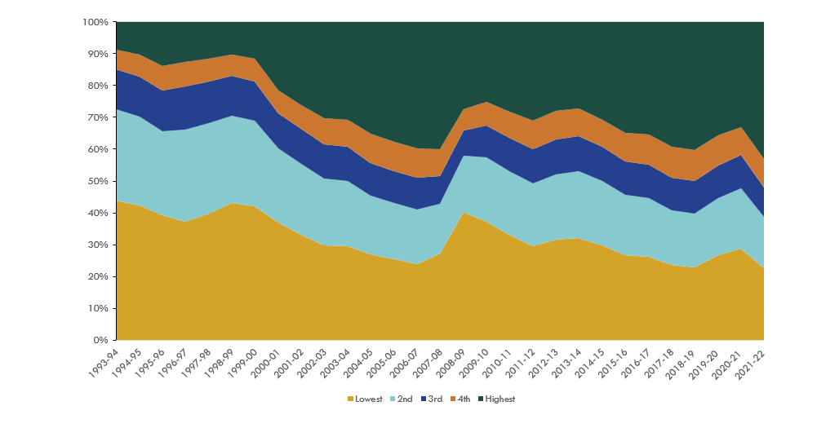
Federal housing expenditures by income quintile

Slide 22
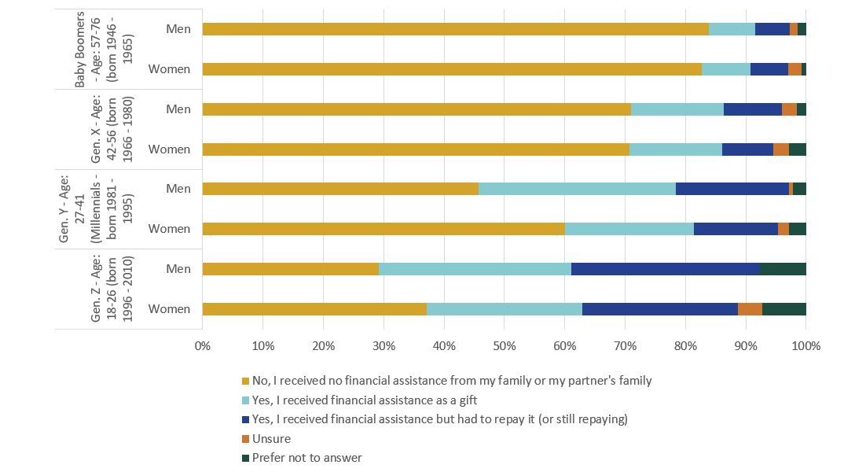
Did you receive any assistance from your family or your partner's family when you purchased your first residential property / house in Australia?
Gender and Generation

