Slide 1
The role of home equity release in retirement: Behavioural factors, aged care and intergenerational aspects Associate Professor Katja Hanewald UNSW Sydney, School of Risk & Actuarial Studies Australian Research Council Centre of Excellence in Population Ageing Research (CEPAR) Melbourne Money & Finance Conference 2024 – “Housing Finance and Housing Markets”, February 2024

Slide 2
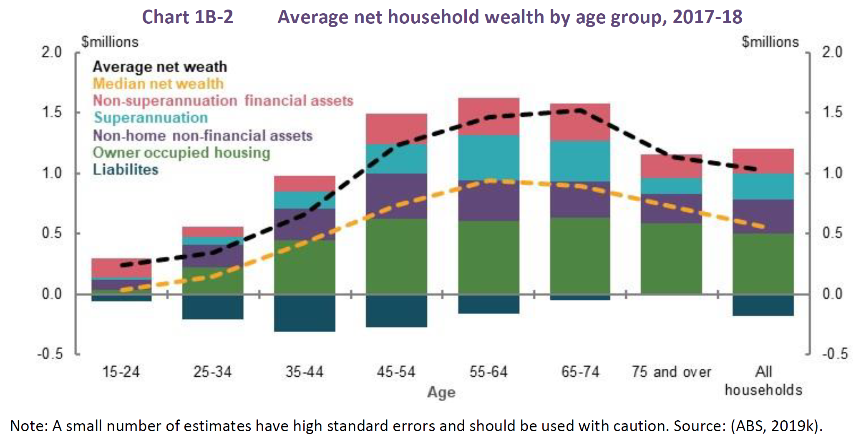
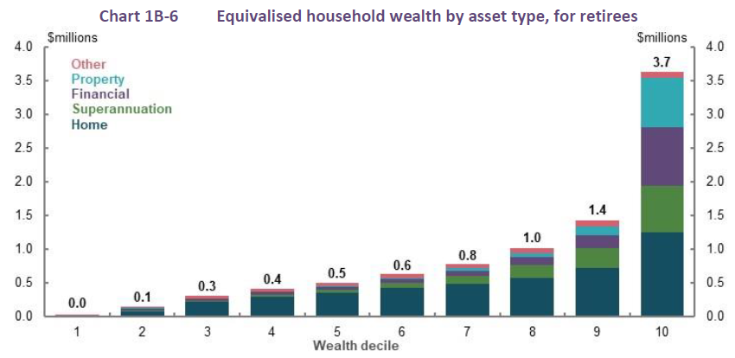
Motivation
Retirement Income Review (Australian Treasury, 2020):
For most households aged 65 and over, the family home is their largest asset
Using superannuation assets more efficiently and accessing equity in the home can significantly boost retirement incomes without the need for additional superannuation contributions
Using relatively small portions of home equity can substantially improve retirement incomes
Releasing home equity can boost retirement incomes with a modest impact on debt

Slide 3
Home equity release options in Australia
Aspect | Home Equity Access Scheme | Commercial Reverse Mortgages
Eligibility | Australian residents, Age Pension age, owning any real estate Australia-wide | Varies by lender; often from age 60; primary residences, holiday homes, or investment properties in capital cities or major metropolitan/regional centres
Administration | Gvt. program administered by Services Australia and the Department of Veterans’ Affairs | Offered by banks and non-bank specialist lenders
Loan Amounts | Annual loan amount capped at 1.5 x max. Age Pension rate (incl. any Age Pension payments), subject to a max. loan balance determined by age and property value | Higher loan amounts; amounts depend on property value, borrower’s age and lender’s policies
Payment Types | Regular fortnightly payments, lump sums, or both, within annual caps | Diverse options, including lump sums, regular income streams, and lines of credit
Repayment Terms | Repayment can be deferred until homeowner permanently moves from home (including upon death)
Age Pension Implications | No impact on Age Pension if loan is taken as a regular income stream to spend on living expenses or non-assessable assets
Tax Implications | Payments are not taxed
Interest Rates | Fixed government-set rate; currently 3.95% p.a. (last changed on 1 January 2022) | Mostly variable interest rates; currently 8.4% - 9.6% p.a.
Consumer Protections | No egative equity guarantee | No negative equity guarantee; ASIC and responsible lending requirements
Notes:
Downsizer contributions (to superannuation account). $300K. 4,500 used scheme in first 3 years
Home reversion (sell part of house)
Private reverse mortgage (borrow using house as collateral).10s of 1000s of contracts
Publicly provided reverse mortgage HEAS (Home Equity Access Scheme). <10,000 participants

Slide 4
Home Equity Access Scheme
1 Jul 2019:
PLS opened to all property-owning Australians of pension age
Max. amount increased to 150% Age Pension
1 Jan 2020: Interest rate cut (from 5.25% to 4.50%)
1 Jan 2022:
Rebranding from PLS to Home Equity Access Scheme
Interest rate cut (from 4.50% to 3.95%)
‘Improved public messaging and branding’
1 Jul 2022:
Two lump sums p/y
No negative equity guarantee
Jan 2023: Planners can advise on the HEAS without credit license
10,475
768
Source: Data provided by the Department of Social Services.

Slide 5
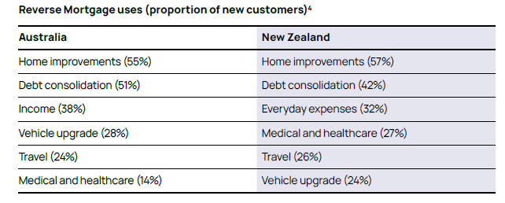
Reverse mortgages
Heartland Finance: largest active RM provider in Australia, market share: 39.9%; has “helped more than 26,000 Australians”
Heartland reports strong growth in its reverse mortgage business in Australia in the FY2023, with receivables increasing by 20.7% to $1,54 bn
Household Capital reported a 50% year-on-year growth in their reverse mortgage portfolio in December 2023
Source: Heartland Group 2023 Annual Report

Slide 6
Previous research
Lifecycle models: Australia (Hanewald et al., 2016; Shao et al., 2019; Andreasson and Shevchenko, 2021; Koo et al., 2022); Canada (Michaud and St Amour, 2023) US (e.g., Davidoff, 2009, 2010, 2015; Nakajima and Telyukova, 2017; Cocco and Lopes, 2020; Achou, 2021) Reverse mortgages (on their own and combined with LTCI, annuities) can be welfare enhancing. Models predict a higher demand for reverse mortgages among individuals with lower levels of financial wealth relative to housing wealth, weaker bequest motives But: Take-up is low internationally | Empirical/surveys: Australia (Jefferson et al., 2017); Canada (Choinière-Crèvecoeur and Michaud, 2023); China (Hanewald et al., 2020); Italy (Fornero et al., 2016); Netherlands (Dillingh et al., 2017); Singapore (Fong et al., 2023); US (Davidoff et al., 2017) Low reverse mortgage demand can be explained by: low product awareness lack of understanding of a complex product high costs aversion to debt bequest motives (mixed) intergenerational expectations

Slide 7
What is the role of behavioural factors, aged care and bequests as factors affecting the take-up of equity release in Australia?

Slide 8
Our team
Associate Prof Katja Hanewald
Prof Hazel Bateman
Postdocs and (former) students
Dr Tin Long Ho
Dr Chelle Wang
Dr Hanlin Lou
Katie Sun
Scott Shao
UNSW Sydney, School of Risk & Actuarial Studies
Australian Research Council Centre of Excellence in Population Ageing Research (CEPAR)

Slide 9
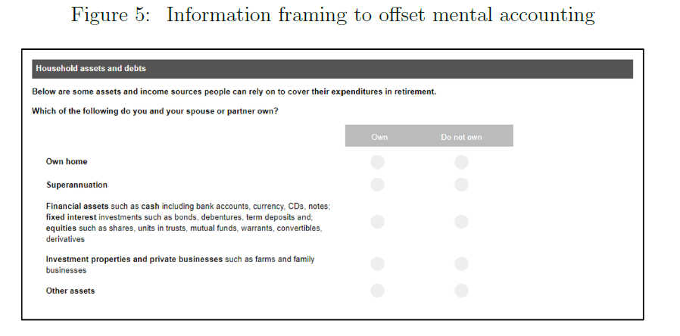
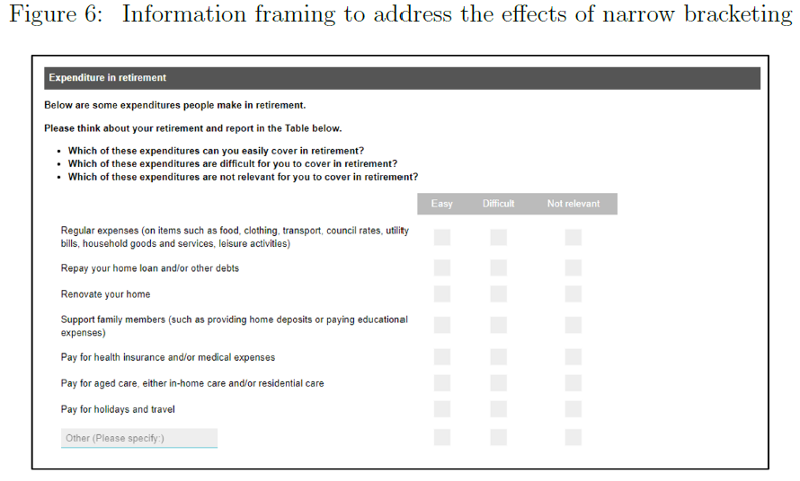
Behavioural factors
Ongoing research: Bateman, H., Hanewald, K., Ho, T. L., & Lou, H. (2024). Demand for Reverse Mortgages: Behavioral Explanations, Working paper, UNSW Sydney.
Multi-period stochastic simulation model to assess the potential benefits of RMs for different retiree households
Online experimental survey of Australian homeowners aged 60-80
Information treatments aimed at mitigating behavioural biases: mental accounting, narrow bracketing, product complexity
Also: data on demographics, household finances, personal preferences, financial capability, and psychological traits to explore the influence of economic and personal factors on reverse mortgage demand.

Slide 10
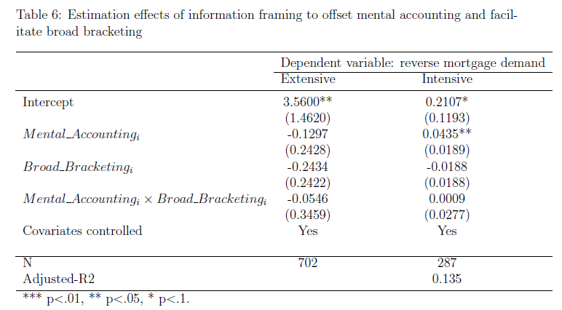
Behavioural factors
Results: Behavioural barriers significantly influence RM demand
Clear, case-study-based product information significantly improves understanding of reverse mortgages, thereby addressing product complexity.
Information treatments countering mental accounting and narrow bracketing were positively associated with demand, especially among participants with low income but high housing wealth.
Economic factors (experiencing financial stress), risk preferences (risk tolerance), and negative perceptions of the equity release product were also influential.

Slide 11
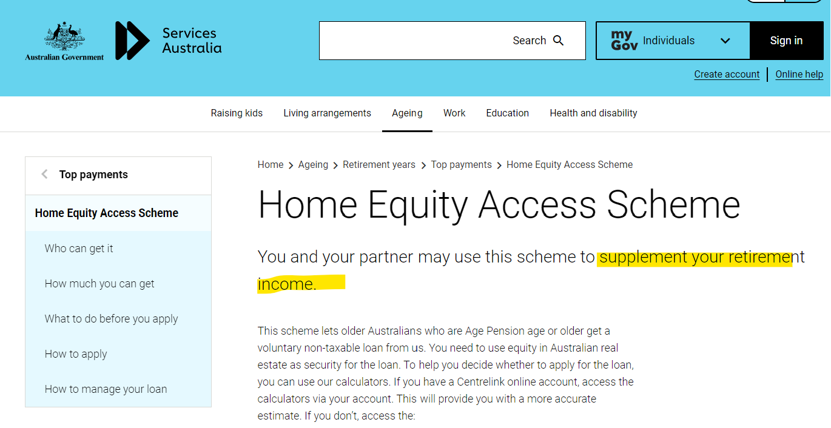
Behavioural factors
Comment: HEAS design already addressing behavioural barriers to RMs demand:
HEAS payments linked to Age Pension payments
→ Housing wealth ‘framed’ as part of the mental account to finance retirement
→ Less complex than a separate RM product
Notes:
Risk exposure
RM: homeowner benefits from house price increases, is protected from decreases through the NNEG
HR: symmetric exposure to house price risk
Timing of payouts
RM: higher payouts at t = 0, loan repaid at termination
HR: lease-for-life costs subtracted from lump sum at t = 0

Slide 12
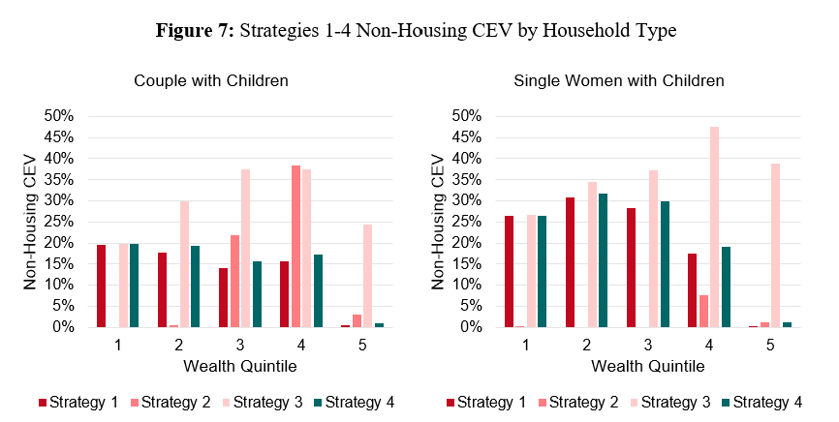
Home Equity Access Scheme
Which households could benefit from the HEAS?
Simulation study evaluating the HEAS for different household types
Compare different strategies (ASFA comfortable, 70% replacement, max., ASFA comf. +X)
Model longevity/long-term care/house price/interest rate risk, bequest
Results:
Many Australian households could benefit from the HEAS
Max. HEAS payments often give best ‘outcome’
Advances can be used to cover aged care, other costs
Sun, K., Bateman, H., and Hanewald, K. (2024), Funding retirement with public reverse mortgages: An evaluation of Australia’s Home Equity Access Scheme. Working paper, UNSW Sydney.
Notes:
Risk exposure
RM: homeowner benefits from house price increases, is protected from decreases through the NNEG
HR: symmetric exposure to house price risk
Timing of payouts
RM: higher payouts at t = 0, loan repaid at termination
HR: lease-for-life costs subtracted from lump sum at t = 0

Slide 13
Aged care
Home equity release could provide additional funding for aged care
Several possible mechanisms (Hanewald et al., 2020b):
HEAS could be extended:
Introduce flexible withdrawal options and increased borrowing limits for aged care expenses
Provide information/advice on using HEAS for aged care funding
Developing partnerships between HEAS and aged care providers for direct fund usage
Integrating HEAS with existing aged care policies and funding mechanisms
Unlocking housing wealth |  | Fund aged care
Sale | + | Cover costs as they arise
Home equity release |  | Buy long-term care insurance

Slide 14
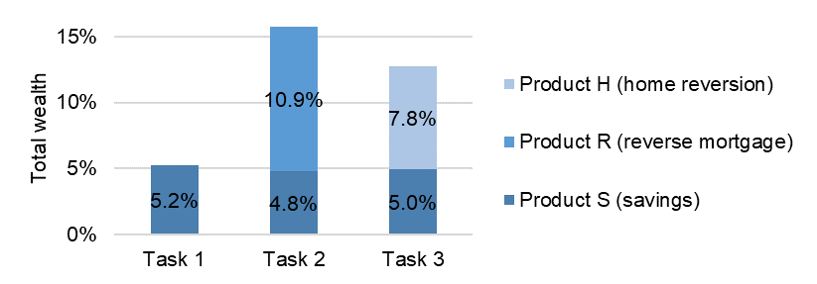
Aged care
Would people use their housing wealth to buy long-term care insurance?
Online survey of 1,200 Chinese homeowners aged 45-64
Results: individuals would buy more LTCI when they can use housing wealth
Hanewald, K., Bateman, H., Fang, H., & Ho, T. L. (2022). Long-term care insurance financing using home equity release: Evidence from an online experimental survey (No. w29689). National Bureau of Economic Research.

Slide 15
Bequest motives
Bequest motives – often cited as a reason for low uptake of home equity release/RMs
But: Home equity release can allow families to
‘bring forward’ bequests and
reduce the uncertainty around bequest timing.
Robert Merton (2007): “It [a reverse mortgage] can also be a far more efficient way of creating a bequest than holding onto a house and leaving it to heirs. After all, one does not have to be an expert to know that it is probably far from optimal bequest policy, from the point of view of the heirs’ utility, to receive the value of the house as a legacy at some uncertain time in the future—perhaps next year, perhaps in 30 years.”
Many Australian parents help their children buy property using financial wealth
Home equity release could provide additional funding to the “Bank of Mum and Dad”

Slide 16
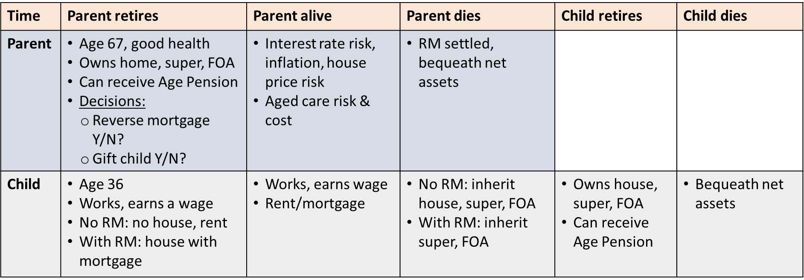
Bequest motives
Could equity release provide retirement income and fund the ‘Bank of Mum and Dad’?
Simulate retirement outcomes for different household, assume parent cares about child
Compare leaving a bequest vs. gifting earlier via a reverse mortgage product
Results: many families could benefit from using a reverse mortgage to supplement parental retirement income and fund a child’s home loan deposit
Wang, Y., Hanewald, K., Bateman, H., and Shao, S. (2024). Home Equity Release: Retirement Income and the ‘Bank of Mum and Dad’, work in progress.

Slide 17
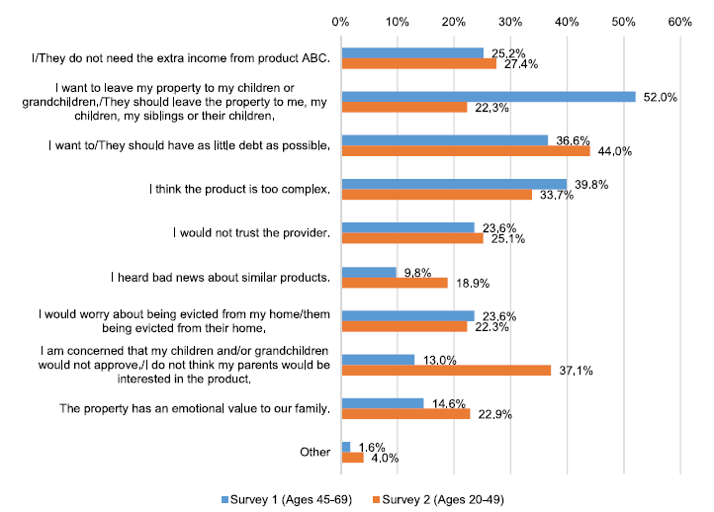
Bequest motives
What do different generations expect?
Hanewald et al. (2020a): Two large surveys to assess the potential demand for RMs in China
We developed a flexible product design addressing the shortcomings of an unsuccessful reverse mortgage product piloted in China
Results:
Strong interest among educated urban Chinese: older homeowners and adult children
Discrepancies in expectations regarding property inheritance between generations
Conclusion:
Equity release options should be advertised to families
Families should be encouraged to discuss the use of housing wealth
Hanewald, K., Bateman, H., Fang, H., & Wu, S. (2020a). Is there a demand for reverse mortgages in China? Evidence from two online surveys. Journal of Economic Behavior & Organization, 169, 19-37.

Slide 18
Conclusion
For most households aged 65 and over, the family home is their largest asset
Home equity release allows retirees to:
Supplement retirement income, age in place, fund aged care, bring forward and ‘time’ bequests, …
Yet, take-up of home equity release (including the HEAS) remains low
Research shows how barriers to take-up could be overcome:
Behavioural barriers (complexity, mental accounting and narrow bracketing): clear, case study-based product information and communication strategies (Bateman et al., 2024; Sun et al., 2024.)
Concerns about aged care expenses: include aged care financing in program/product design (Hanewald et al. 2020b; Hanewald et al., 2024.)
Bequests: Home equity release allows families to control the timing of intergenerational wealth transfers (Wang et al., 2024.)

Slide 19
Thank you! Contact: Katja Hanewald k.hanewald@unsw.edu.au

